Slide 1
Unit 3
“The focus of this unit is the health of specific populations. Within Australia and across the globe, there are groups who do not enjoy the same level of health as the general population. Students learn about factors creating these disparities and ways of improving the health and wellbeing of specific groups through priority health approaches. They examine models and social justice principles which can be applied to address health inequity, and review actions and strategies focusing on reducing inequities. The influence of attitudinal and environmental influences on the health of specific groups is explored. Students examine and interpret relationships in data which explain disparities in health through the application of critical inquiry skills.”
-SCSA Syllabus

Slide 2
Socio-ecological model
Term 1
Week 1

Slide 3
Syllabus content
Socio-ecological model of health and its role in understanding and addressing public health problems
Individual
Interpersonal
Organisational
Community
Society

Slide 4
Definition of health
What is health*??
According to WHO:
“a state of complete physical, mental and social wellbeing, free from disease and illness”

Slide 5
Socioecological (social) Model of Health
Introduction to the socioecological model of health:
1. What does it look like?
2. Why does it exist?
3. What information does it provide us with?
4. How we can use it?
5. Individually break down each level and isolate each component.
6. Explore the relationship between each section of the model.
7. Apply it to examples.

Slide 6
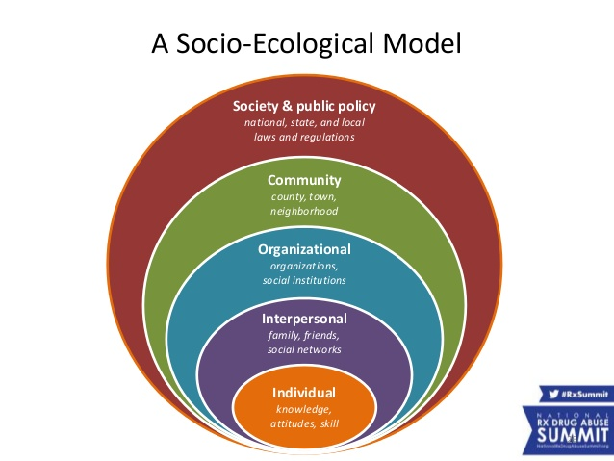
1. What does it look like?
Socioecological model*: A conceptual model that outlines how the health status of an individual is influenced not only by their attitudes and behaviours but also by their relationships, community and society.
Image from Pharmacy Track: Pharmacists Working With Local Coalitions and PDMPs via Slideshare.net

Slide 7
2. Why does it exist?
Human behaviour is influenced by a variety of factors.
Understanding how these factors interrelate is important in understanding how they influence behaviour
It can be used to help explain why certain behaviours are more prevalent in particular populations
When we know why certain behaviours are more prevalent we can implement a public health approach to preventing harm and illness and in turn, improve health.

Slide 8
3. What information does it provide us with?
The five “nested” levels cover a variety of factors that can influence human behaviour.
We can also see how the factors within each level interact with each other to contribute to certain behaviours.
It can help explain behaviours AND be used to guide health promotion to address unhealthy behaviour.

Slide 9
4. How can we use it?
It needs to be understood as a SYSTEM.
Health promoters can apply the model to help gain understanding of the factors that influence human behaviour, and how these factors interrelate.

Slide 10
5. Breaking down each level:
Individual
Interpersonal
Organizational
Community
Societal

Slide 11
Individual LEVEL
Characteristics of the individual including knowledge, attitudes, behavior, self-concept, skills and decision making. Includes:
Biological factors (genetics)
Demographics (age and gender, racial ethnicity)
Personality and emotional intelligence
Intentions, will and self-control
Literacy (and health literacy) levels
Sexual orientation
Attitudes, beliefs and values
Financial resources

Slide 12
Interpersonal LEVEL
Explores how close relationships impact health behaviors. Examines dynamic between family members, co-workers, friends and peers, other relationship patterns and family connectedness. Includes:
How close relationships influence health behaviours
Consider which relationships influence the most, and how we are influenced by different types of relationships. (ie parents vs peers)
An individuals communication skills (Leadership, tolerance, respect for others)

Slide 13
Organisational LEVEL
Examine the way that a person lives, works and learns within the rules, policies and expectations of institutions. (Schools, churches, workplaces, community organizations, healthcare services)
Includes:
Rules of organisations
Policies of organisations
Expectations within organisations

Slide 14
Community LEVEL
Community contexts in which organisations may interact as well as the community norms that cross all organisations within the community.
Individuals within a community will usually bring the cultural and community norms with them to interpersonal and community settings.
Includes:
Businesses
Transportation
The built environment (eg. Parks and buildings)
Community villages

Slide 15
Societal lEVEL
Examines factors such as:
Cultural norms and collective attitudes
Economic and social policies (legislation at a local, state and national level)
Restrictive policies such as high taxes
A lack of policies (eg. Requirements for childhood immunisations)
Political structures (democracy or other voting systems)
Eg. “Western culture” or “Asian culture”

Slide 16
6. Relationships between each level
It is important to understand that the levels invariably overlap and interact with each other.
Eg. Interpersonal interactions happen in the organisational level
Eg. Individuals bring the cultural and community norms with them into interpersonal and organisational settings.

Slide 17
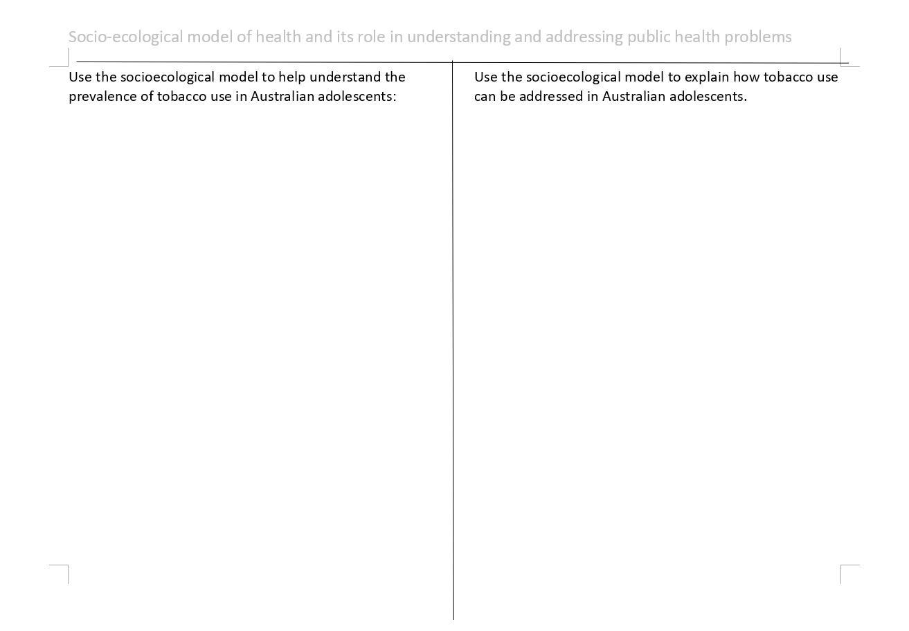
7. Application
Example: Tobacco use in adolescent Australians.
Complete the worksheet:
Use the socioecological model to help understand the prevalence/use of tobacco use in Australian adolescents.
Use the socioecological model to explain how tobacco use can be addressed in Australian adolescents.

Slide 18
Apply it!
Individual (understanding)
Young people are more likely to engage in risk taking behaviour. (eg. Young Males)
Individuals who have lower levels of emotional intelligence are more likely to be persuaded to use drugs and alcohol
Some personality traits such as addictive personalities or attention seeking personality traits are more likely to use drugs and alcohol (or become dependent on them)
Individuals who have lower levels of health literacy are more likely to engage in tobacco use
Individuals who show more self discipline and self control are less likely to use tobacco
Individual (addressing)
Increase health literacy through school health education about the effects and risks associated with tobacco use.
Influence attitudes, beliefs and values regarding tobacco use through education.

Slide 19
Apply it!
Interpersonal (understanding)
An individual is more likely to try tobacco if their partner, close friends or family members use it.
Interpersonal (addressing)
Parent education programs to increase parents understanding of how their behaviours regarding tobacco can influence their children.

Slide 20
Apply it!
Organisational (understanding)
School/workplace/sporting clubs policies that ban tobacco use will reduce the likelihood that individuals associated with those institutions will use tobacco
If an individual works a job that does not provide facilities (ie. Outdoor spaces) to tobacco use then they are less likely to use it or more likely to quit.
Organisational (addressing)
Make QUIT programs available through workplaces
Ensure school and club policies have strict rules regarding tobacco use.

Slide 21
Apply it!
Community (understanding)
If there is a community norm of tobacco use (eg. A rural community) the individuals who are involved in that community are more likely to engage in tobacco use.
If an individuals family and friends choose NOT to use tobacco, they will often take this cultural norm with them into communities they are involved in.
Community (addressing)
Make sure tobacco use zones are limited and far from public places.
Implement social marketing campaigns within the community to promote the advantages of not-smoking.

Slide 22
Apply it!
Societal (understanding)
Western/Asian/European cultural norms of tobacco use?
Taxation system associated with tobacco use. (strong tax system means individuals are less likely to engage in tobacco use)
Societal (addressing)
Ensure that there is high federal tax on tobacco products
Ensure there are strict federal policies regarding where/when you can smoke in public places

Slide 23
HOmeWORK: Application Question
DUE: __________________________
Use the socioecological model to explain the increased prevalence of obesity in rural/remote areas.
(5 marks)

Slide 24
References
Lockhart, E. (2015) Health Studies Year 12 ATAR.

Slide 25
Maslow’s Hierarchy of Needs
Term 1
Week 2

Slide 26
Syllabus content
Purpose and characteristics of the five levels of need within Maslow’s Hierarchy of Needs

Slide 27
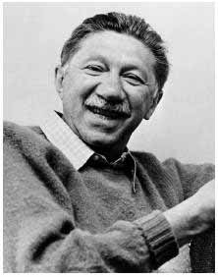
Mr. Maslow
Abraham Maslow (1908 – 1970) was an American psychologist who was best known for creating Maslow's hierarchy of needs, a theory of psychological health predicated on fulfilling innate human needs in priority, culminating in self-actualization.
“The ability to be in the present moment is a major component of mental wellness.”
https://www.youtube.com/watch?v=O-4ithG_07Q

Slide 28
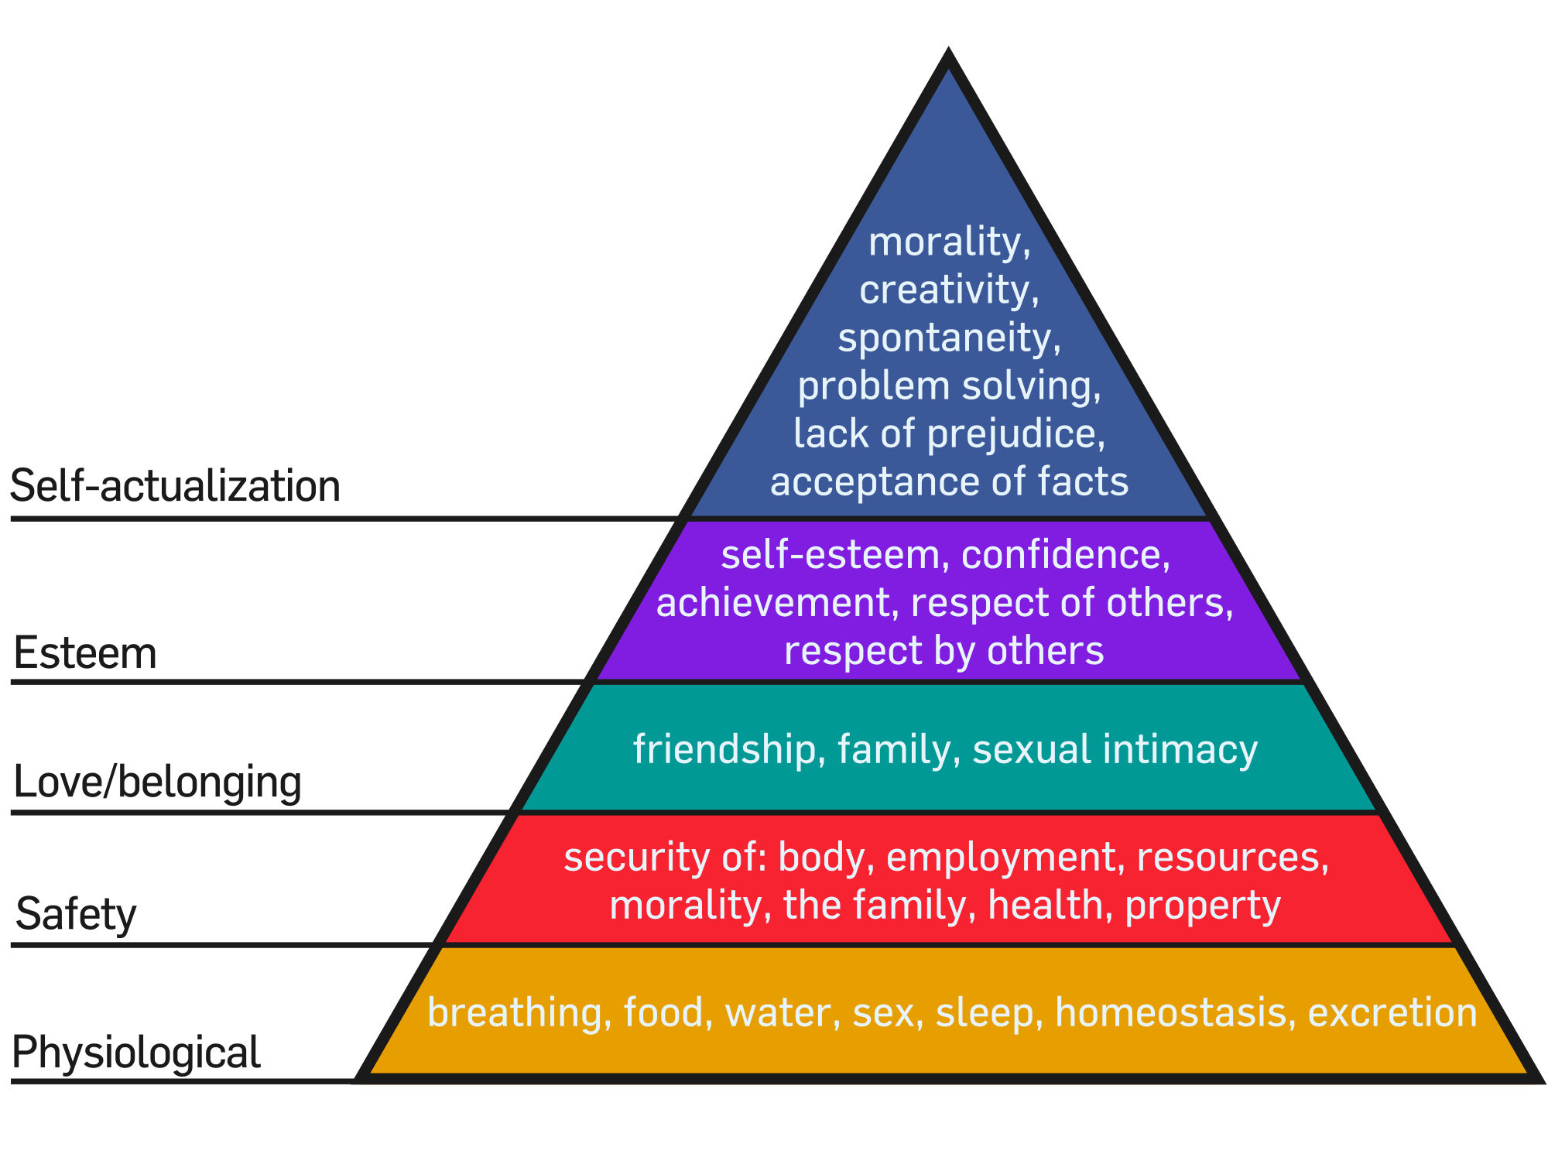
Image used with permission from Wikimedia.org

Slide 29
4 types of needs that must be satisfied before a person can act unselfishly (achieve self-actualization).
Needs are arranged in a hierarchal order. Climbing the hierarchy is achieved by satisfying one set of needs at a time.
Basic needs are physiological, followed by a need for safety, then the desire for love, followed by the quest for esteem.
Humans are driven to satisfy the lower needs however we are drawn to meet the higher ones.
Deficiency needs (lower 4 needs)- lacking these needs create tension within the individual.
IT’S ALL ABOUT WHAT MOTIVATES OUR BEHAVIOUR.
Griffin, G. (n.d.). A First Look at Communication Theory.

Slide 30
Physiological needs
Class Discussion: What do we need to purely SURVIVE?
Air
Food
Water
Sleep
If these basic needs are not met, then an individual will not consider higher needs such as safety or esteem.

Slide 31
Safety needs
Once our basic survival needs are met, we turn to keeping ourselves SAFE and SECURE.
Safety needs: safety and security in order to be free from the threat of physical and emotional harm
Living in a safe area
Medical insurance
Job security
Financial reserves
If an individual does not feel safe and secure, they will not consider higher needs such as esteem or “social needs”.

Slide 32
Social needs
Once we can SURVIVE and we feel SAFE and SECURE, we pursue our desires to be SOCIAL through interaction with others.
This desire to belong and be loved might be fulfilled by:
Friendship
Belonging to a group
Giving and receiving love
Intimate relationships
Until we feel like we “belong” we will not consider the need to feel important.

Slide 33
esteem needs
When we feel accepted and loved by those around us we seek out the feeling of importance and recognition. Esteem needs: broken down in to external and internal motivators.
EXTERNAL: Things that drive you are beyond your control-things like
Recognition
Attention
Social status
INTERNAL: The things that drive you are about making yourself better-things like
Accomplishment
Self respect

Slide 34
Self actualisation
Self-Actualisation: the summit of the theory. (all other needs must be met)
Unlike the lower levels, this need is never fully satisfied (as individuals grow psychologically, so do the opportunities presented to them)
Self actualised people tend to have motivators such as:
Truth
Justice
Wisdom
Meaning

Slide 35

Characteristics of a self-actualized person
Peak experiences
Self Acceptance
Realistic
Problem-centred
Autonomous
Spontaneous
This Photo by Unknown Author is licensed under CC BY-SA

Slide 36

Peak Experiences
One characterization of self-actualization is having frequent peak experiences.
According to Maslow,¹﻿ a peak experience involves:
"Feelings of limitless horizons opening up to the vision, the feeling of being simultaneously more powerful and also more helpless than one ever was before, the feeling of ecstasy and wonder and awe, the loss of placement in time and space with, finally, the conviction that something extremely important and valuable had happened, so that the subject was to some extent transformed and strengthened even in his daily life by such experiences."

Slide 37

SELF ACCEPTANCE
Self-actualized people accept themselves and others as they are. They tend to lack inhibition and are able to enjoy themselves and their lives free of guilt.
Not only do self-actualized people fully accept themselves, they also embrace other people for who they are. Other individuals are treated the same regardless of background, current status, or other socio-economic and cultural factors.
This Photo by Unknown Author is licensed under CC BY-SA-NC

Slide 38

Realistic
Another major characteristic of self-actualized people is a sense of realism. Rather than being fearful of things that are different or unknown, the self-actualized individual is able to view life as it unfolds both logically and rationally.
This Photo by Unknown Author is licensed under CC BY-SA-NC

Slide 39

Problem-centred
Self-actualized individuals are often motivated by a strong sense of personal ethics and responsibility. They enjoy applying their problem-solving skills to real-world situations and they like helping other people improve their own lives.

Slide 40
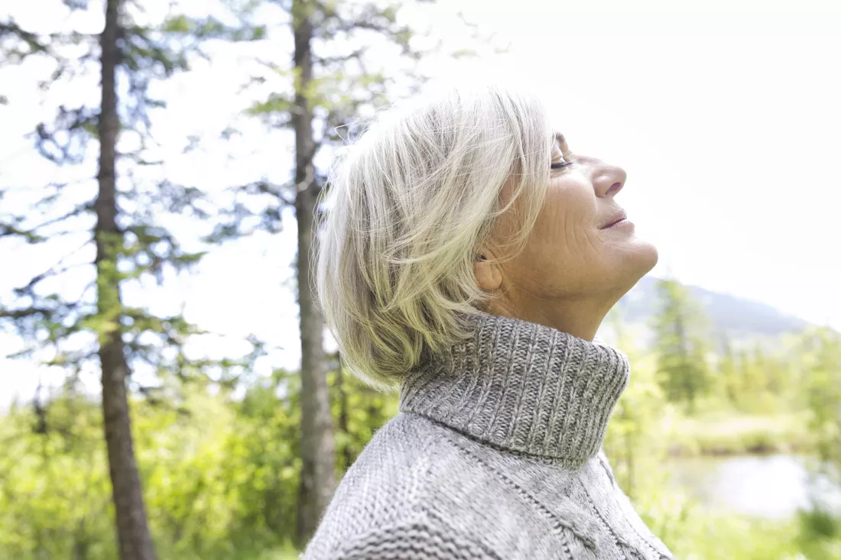
Autonomous
Self-actualized people also tend to be very ​independent. They don't conform to other people's ideas of happiness or contentment. This original perspective allows the individual to live in the moment and appreciate the beauty of each experience.

Slide 41

Spontaneous
Another characteristic of self-actualized people is a tendency to be open, unconventional, and spontaneous. While these people are able to follow generally accepted social expectations, they don't feel confined by these norms in their thoughts or behaviors.

Slide 42
Questions to consider
Do you think individuals who have reached self actualisation are healthier than those who haven’t? Why or why not?
How does Maslows Hierarchy of needs fit with human rights?
** Take a look at The Universal Declaration of Human Rights (UN Website)
http://www.interfaces.com/blog/2013/09/health-human-rights-and-maslows-hierarchy-of-needs/

Slide 43
Are you self-actualized?
Take the quiz online at Explore Psychology
https://www.explorepsychology.com/wp_quiz/self-actualization-test/

Slide 44
RESOURCES
Lockhart, E. (2015) Health Studies Year 12 ATAR.
9 Characteristics of Self-Actualized People By Kendra Cherry
https://www.verywellmind.com/characteristics-of-self-actualized-people-2795963

Slide 45
Characteristics and needs of specific populations
Term 1
Week 3-4

Slide 46
Syllabus content
Characteristics and needs of specific populations
Access and equity issues of specific populations
Quantitative and qualitative measures for detecting health inequities and/or injustices
Epidemiological data
Social determinants of health

Slide 47
What is a specific population?
A subgroup of the main population of a country or state. It consists of a group of people with similar characteristics and/or needs.
What are some examples of specific populations in Australia? (all identified as “priority groups” by AIHW)
Mothers and Babies
Males/Females
Individuals who are or have been incarcerated (Prisoners)
Children/Youth
Aboriginal & Torres Strait Islanders (Indigenous)
Individuals living in rural/remote areas
War Veterans
Older people (The Elderly)
Socioeconomically disadvantaged people
WORKSHEET: We are going to look at these ones in more detail

Slide 48
Specific populations worksheet
Using the following research documents to complete the worksheet, outlining the characteristics and needs of the specific populations identified on the previous slide.
(We will come back to complete the “access and equity” issues later)
Characteristics:
Features or qualities that typically belong to that group. Characteristics “define” and “identify” groups from the general population.
Needs:
What the group requires to achieve good/better health. Consider what their deficits are, and what they might need to overcome these. (consider the kinds of problems they have and what they require)

Slide 49
Research documents
Aboriginal & Torres Strait Islander People:
Summary of Aboriginal and Torres Strait Islander health status 2019
Elderly People:
https://www.aihw.gov.au/reports/older-people/older-australia-at-a-glance/contents/summary
Individuals living in Rural/Remote areas:
https://www.aihw.gov.au/reports/rural-remote-australians/rural-remote-health/contents/summary
Socioeconomically Disadvantaged people:
https://www.ausstats.abs.gov.au/Ausstats/subscriber.nsf/0/5703A93771AE2E4ECA2576E70016C8D3/$File/41020_%20healthandseifa.pdf

Slide 50
Discuss
All Australians are entitled to choices and opportunities that facilitate good health, and to be free from discrimination.
In reality does this happen?
Watch the following documentary episode and discuss/answer the questions that follow:

Slide 51
First Contact Episode #1 (Sbs)
https://www.sbs.com.au/ondemand/video/352505923803/first-contact
What specific populations are we exposed to in this documentary?
For each of the specific populations what are the health issues that they are faced with?
What factors contribute to each of these health issues?

Slide 52
Access & equity issues of specific populations
First, let’s define these terms:
*Access: The right to obtain something or make use of something. The ability to reach or gain entry into a place or service.
*Equity: All people have an equal opportunity to develop and maintain health through fair and just access to resources for health. (allocation according to need)
*Health inequities: Avoidable inequalities in health between groups of people within countries and between countries. These inequalities are unfair or unjust.
*Health inequalities: Differences in health status or in the distribution of health determinants between different population groups. For example, differences in mortality rates between people from different social classes (World Health Organisation)

Slide 53
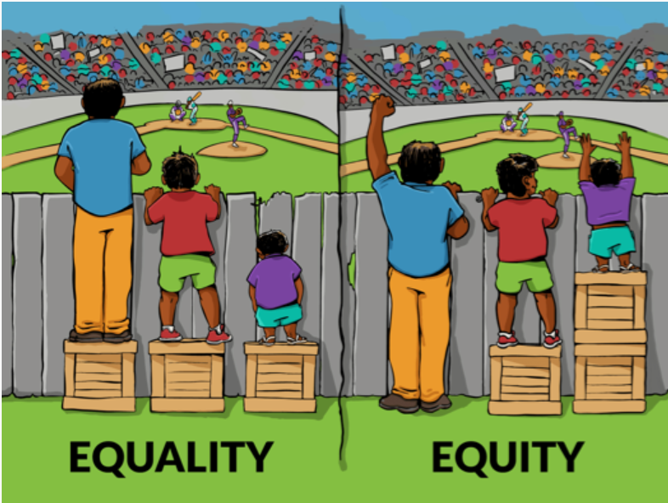
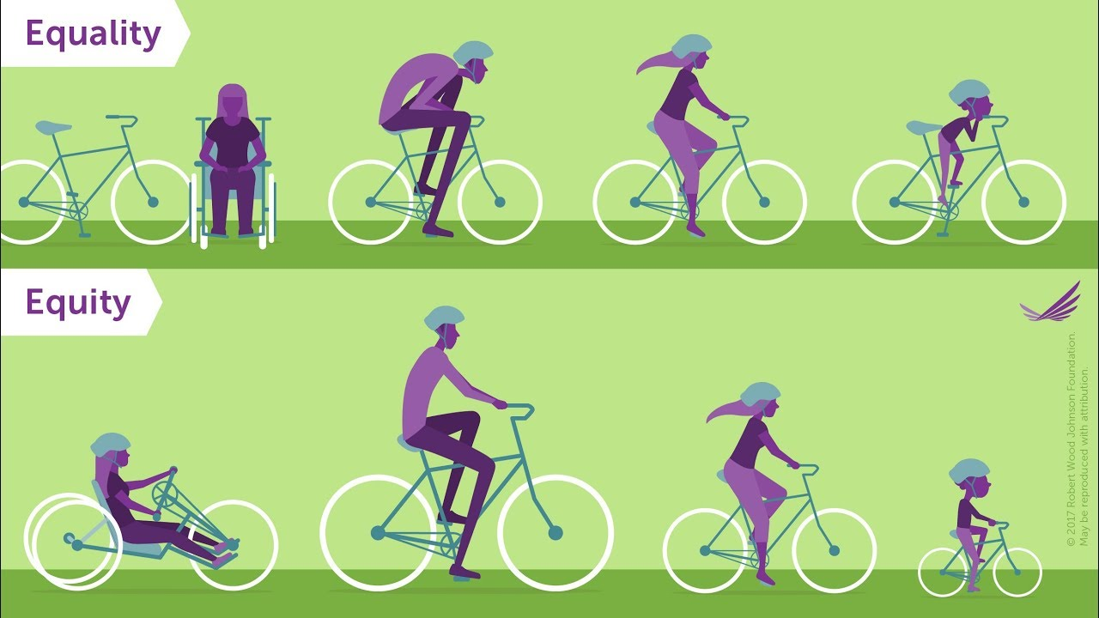

Equality vs Equity (2mins)
https://www.youtube.com/watch?v=MlXZyNtaoDM

Slide 54
Access and equity
“Access and equity” opens the door for increased opportunities for specific populations to achieve the same level of health as the main population.
There are often barriers that make it difficult for people in these specific populations to access health services.
Let’s take a look at an example of these barriers:
“Swimming the River” (5 mins)
https://www.youtube.com/watch?v=0P9FRacTji0

Slide 55
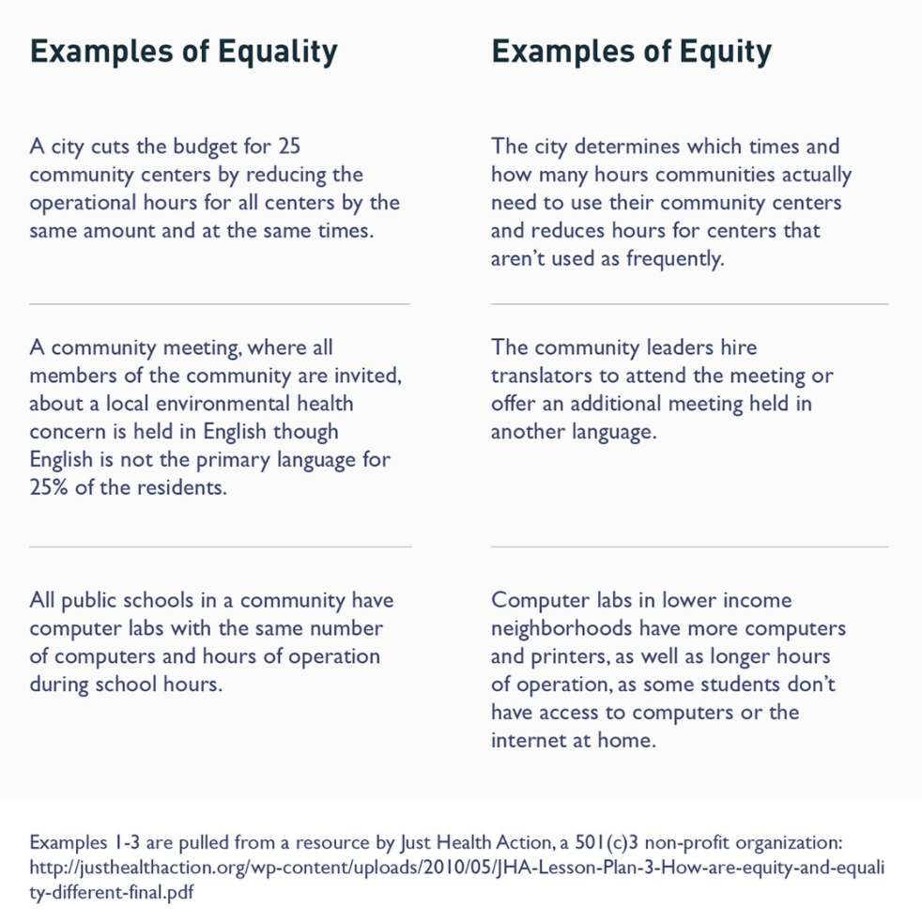

Slide 56
Health promotion needs to address the issues of access and inequity.
What does health promotion like this look like?
Health promotion gives priority to specific populations who are “at risk”
Health promotion focuses health initiatives to target the social determinants of health.
Health promotion aims to REDUCE INEQUITY.

Slide 57

remember: 5 A’s of Access
Affordability- Can people pay for the cost of the service or product?
Accessibility- Can all people use the service properly?
Acceptability- Does the service respect all values, beliefs and attitudes?
Availability- Are the services open and able to be used when required?
Adaptability- Can services be changed or modified when needed?
Can Vegetarian Ducks Fly and Clap?

Slide 58
Global vs Regional health inequities
GLOBAL:
The infant mortality rate (the risk of a baby dying between birth and one year of age) is 2 per 1000 live births in Iceland and over 120 per 1000 live births in Mozambique.
The risk of maternal death during or shortly after pregnancy is only 1 in 17 400 in Sweden but it is 1 in 8 in Afghanistan.
REGIONAL:
USA-African Americans represent about 13% of the population but account for almost 50% of all new HIV infections. (There is no biological or genetic component)
AUSTRALIA-Life expectancy of Indigenous Australians is significantly lower than non-Indigenous Australians (males 59.4yrs VS 76.6yrs, females 64.8yrs VS 82yrs)
All statistics from World Health Organisation.

Slide 59
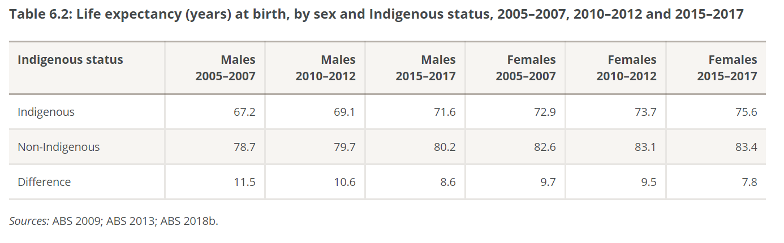

Slide 60
Measuring health inequities
How can we measure health inequities?
QUANTITATIVE MEASURES
Derived from the word “quantity”
Refers to data and statistics (number measurement)
Examples include life expectancy, percentages of disease prevalence etc.
2. QUALITATIVE MEASURES
Derived from the word “quality”
Refers to descriptions, photo and video depicting quality of life.

Slide 61
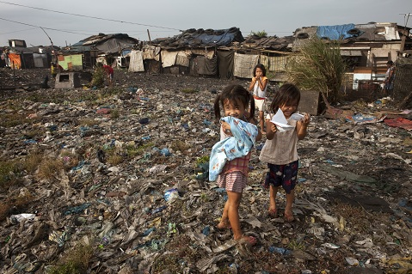
Quantitative vs Qualitative:
842 000 Diarrhoeal diseases deaths per year resulting from lack of safe drinking-water and inadequate sanitation and hygiene.
Information retrieved from: https://www.who.int/sustainable-development/cities/health-risks/slums/en/

Slide 62
Qualitative and quantitative measures
Q. How do these work together to determine the presence of inequity?
A. The quantitative data gives information about how much disease there is and who has the disease, and qualitative helps explain why or how.
Q. How can they explain why this inequity occurs?
A. The qualitative data can give information on why the disease is present and what might be causing the health problems.

Slide 63
Finish specific populations worksheet
Complete the last component of the worksheet, outlining the access & equity issues faced by each specific population

Slide 64
Social justice
Term 1
Week 4

Slide 65
Syllabus content
Social justice principles in health
Access and equity
Diversity
Supportive environments

Slide 66
What is social justice?
*Social justice is when all people in our world are considered in a fair and equitable manner, including the distribution of wealth, opportunities, and privileges within a society.
Ie. Individuals who live in lower socioeconomic areas or isolated communities should have the same access to healthcare services and education as the general population.
There are THREE main principles of Social Justice that aim to reduce health inequities in Australia.

Slide 67
3 Principles of Social Justice
1. Access & Equity
3. Diversity
4. Supportive Environments

Slide 68
1. ACCESS & equity
This means that resources are allocated in accordance with the needs of individuals and populations with the overarching goal of equal health outcomes.
Example: Certain population groups are allocated more funding because they are identified as priorities because of their lower health outcomes (ie. Indigenous)

Slide 69
another perspective via youtube
https://www.youtube.com/watch?v=4K5fbQ1-zps
“A life of Privilege explained in a $100 race”

Slide 70
2. diversity
Refers to respecting and accounting for the differences that exist between individuals and people groups such as ethnicity, gender, sexual orientation, language, age/generation, socioeconomic status.
Australia is a very diverse multicultural country, which requires several measures to be in place to ensure each people group within our diversity has access to health care and achieves good health outcomes. (account for everyone!)
Examples?
Ensuring that brochures for health care services are in multiple languages and having interpreters in hospitals to allow all individuals to access health information.
Healthcare facilities employ health professionals who are diverse and/or “culturally competent”

Slide 71
3. Supportive environments
Environments where “people live, work and play that protect people from threats to health and that increase their ability to make health-promoting choices.” -PDHPE
The government looks to create supportive environments for all people, but also looks at the environments of particular people groups to determine if these might be reasons for poorer health outcomes.
Example: Ensuring rural and remote locations have fewer fast food outlets and sufficiently stocked grocery stores to promote good nutrition.

Slide 72
Example: closing the gap program
Use the Closing The Gap website and reports to answer the questions below:
https://www.closingthegap.gov.au/
RESEARCH:
What is the primary objective of this program?
Where/when did this program start?
What are the targets of the program?
What strategies have they used to increase equality for Indigenous Australians?

Slide 73
Example: closing the gap program
What is the primary objective of this program?
“to achieving equality for Aboriginal and Torres Strait Islander people in health and life expectancy within a generation.”
Where/when did this program start?
It began as the National Indigenous Health Equality Campaign in 2006 and was formally introduced as “Close The Gap” in December 2007

Slide 74
What are the targets of the program?
In 2008, these targets were set:
to close the life expectancy gap within a generation
to halve the gap in mortality rates for Indigenous children under five within a decade
to ensure access to early childhood education for all Indigenous four year olds in remote communities within five years
to halve the gap in reading, writing and numeracy achievements for children within a decade
to halve the gap for Indigenous students in year 12 attainment rates by 2020 and
to halve the gap in employment outcomes between Indigenous and non-Indigenous Australians within a decade.

Slide 75
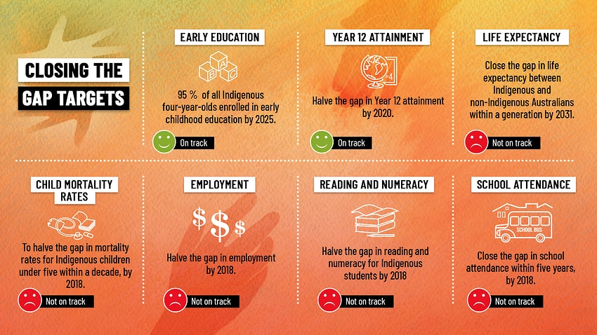
Are we on track?

Slide 76
What strategies have they used to increase equality for Indigenous Australians?
Building partnerships across all levels
Increasing education (at the community level, within healthcare training, teacher training and organisations)
More effective distribution of funding
Increasing participation by Indigenous people in decision making
Improving access to health care (affordability, availability, accessibility)
Improving the cultural knowledge of healthcare professionals

Slide 77
What have we learned?
Research undertaken over the past 10 years has shown us that keys to successful outcomes include:
holistic approaches that work with Aboriginal and Torres Strait Islander people in ways that take into account the full cultural, social, emotional and economic context of Indigenous people’s lives – including an awareness of the ongoing legacy of trauma, grief and loss associated with colonisation
active involvement of Indigenous communities in every stage of program development and delivery
Employing Indigenous staff and involving them fully in program design, delivery and evaluation, and providing adequate training, where necessary, to build capacity of Aboriginal and Torres Strait Islander staff
developing committed, skilled staff (Indigenous and non-Indigenous) and providing diversity and cultural awareness training
adopting a strengths-based perspective that builds and develops the existing strengths, skills and capacities of Aboriginal and Torres Strait Islander people
clear plans for research and evaluation to identify successful aspects of programs

Slide 78
An example...
https://www.sbs.com.au/news/insight/meet-the-aboriginal-doctor-turning-tragedy-to-triumph

Slide 79
Sources
Lockhart, E. (2011). Health Studies Stage 3A-b. Madeley: Print Publishing.
Lockhart, E. (2012). HEA Stage 3 Revision 2012- Lockhart
Workforce Council, Queensland Government retrieved 5th February 2018 from https://www.checkup.org.au/icms_docs/182820_15_FACTSHEET_Social_Justice_and_Health.pdf
Closing the Gap full report retrieved 5th Feb, 2018 from
https://closingthegap.pmc.gov.au
PDHPE website retrieved 6th Feb, 2018 from
https://www.pdhpe.net/health-priorities-in-australia/how-are-priority-issues-for-australias-health-identified/identifying-priority-health-issues/social-justice-principles/

Slide 80
Factors that create health inequities
Term 1
Week 5

Slide 81
Syllabus content
Factors that create health inequities
Discrimination
Gender
Access to health care
Unemployment
Social isolation
Dislocation of land
Occupation
Access to and level of education
Geographic location
Racism
Government economic and social policies
Socioeconomic status
Health literacy

Slide 82
Discrimination
The group experiencing the discrimination may have reduced access to services specific to their health.
They may not want to access health services where they feel undervalued or stereotyped based on their race.

Slide 83
Access to healthcare
People that may need help may not be able to get it due to lack of access.
Access refers to physical/geographical access, financial access or access in the forms of availability and acceptability.
If individuals cannot access healthcare (both preventative and treatment services) they are likely to experience poorer health.

Slide 84
Social isolation
Social isolation can be caused by a range of factors including geographical remoteness and social exclusion based on discrimination and prejudice.
People who cannot participate in society due to isolation will not have limited access to support networks, which creates a barrier to good health.

Slide 85
occupation
People experiencing poor working conditions or who are not being justly rewarded may experience increased mental health issues.
Individuals who are experiencing mental health issues are less likely to experience good overall health, and this can further reduce their ability to work and earn an income. This limits their overall health status.

Slide 86
Geographic location
Individuals and communities that are geographically remote have reduced access to services such as quality education, health services and health products.
Living further from preventative healthcare means individuals are less likely to engage in these services, increasing their risk of disease and poor health.
Medical services located in remote areas tend to be less equipped and have minimal specialist care which makes it difficult to be treated for a specialist condition.

Slide 87
Government economic & social policies
Laws that are discriminatory in any way prevent groups of people achieving good health. (e.g. laws permitting child marriage)
Economic policies influence funding allocations and this can be unfairly distributed causing health inequities.

Slide 88
Health literacy
Poor health literacy means not being able to access, read or understand health information.
This reduces the likelihood that individuals will:
Engage in preventative measures
Know when and how to seek help
Take a proactive approach to improving their own and their families health

Slide 89
Gender
In many parts of the world females still experience discrimination, lack of respect or lack of human rights. This includes reduced access to education, job opportunities and access to birth control (among others.)
We will look at this further later in the course! (GET EXCITED!!!)

Slide 90
unemployment
Those who are unemployed experience social isolation, discrimination and are lower on the social gradient.
Unemployment causes stress (which reduces health status and the capacity to contribute to society)
Unemployment is linked to low income which reduces access to services and healthcare.

Slide 91
Dislocation of land
Dislocation of land refers to the disconnect that one feels to their place of safety, acceptance and “home”. It is often felt by those displaced due to war/conflict or by natural disasters.
Refugees, specific tribal groups and people that have experienced natural disasters may feel lost or disoriented in their new residence.
E.g Being forced to flee from the conflict in Syria to somewhere like Australia often causes one to feel disconnected from their old cultural “home” including distance from sacred religious and cultural sites and communities. (causes stress and loss of identity)

Slide 92
Access to and level of education
This has two components: level of access and level of quality of education.
Individuals and populations who have reduced access (ie geographical location or cultural norms of girls not receiving education) tend to have lower levels of health literacy and therefore poorer health.
Quality refers to the length of education and quality of curriculum, assessment and teaching. (poorer quality education leads to reduced educational outcomes and generally poorer health in later life)

Slide 93
racism
Groups that experience racism will feel socially isolated or discriminated against.
This is likely to lead to a reduction in their ability to access to support or health services which lowers their health status.
Racism can also impact socioeconomic status through education and employment opportunities.
Consider racism through the Black Lives Matter movement regarding police brutality that occurs in racist ways in both the US and Australia.

Slide 94
Socioeconomic status
Socioeconomic status refers to an individual or communities total measure of economic and social position in relation to others.
People that are low on the social gradient will experience poorer health than those that are higher on the social gradient because they cannot afford health products and services to improve their health.
LSES is also associated with unemployment, reduced access to quality education, social exclusion and geographical remoteness.

Slide 95
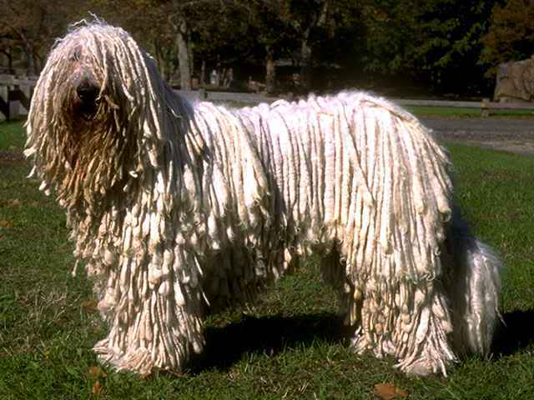
“HUG SAD rag dogs” (mnemonic device)

Slide 96
Past wace question
Complete question 23a from the 2018 WACE exam.

Slide 97
Needs Assessment
Term 1
Week 6

Slide 98
Syllabus content
Steps in Needs Assessment
Identifying health issues
Analysis of the problem
Prioritising issues
Setting goals
Determining strategies
Developing action plans
Evaluating outcomes
Purpose of a Needs assessment
Types of Need
Comparative
Felt
Expressed
Normative

Slide 99
Types of need
There are four types of need: Felt, Expressed, Comparative and Normative.
We are going to define each, and apply them to an example:
The example is the needs of an elderly population within an aged care facility.

Slide 100
Felt need
This is a need that an individual or community perceives for themselves.
You are identifying FELT NEEDS if you conduct a survey to gather information.
EXAMPLE:
Asking the elderly what they feel that the facility can do to provide a better service for them (ie. Asking their opinions via a survey)

Slide 101
EXPRESSED need
A felt need that is turned into action becomes an EXPRESSED NEED. When the individual or community acts on their felt need they are expressing it. (what they demand through action)
This often includes waiting lists for doctors surgery and hospitalization rates.
EXAMPLE:
The number of elderly individauls who reach out to the in-house counselling service demonstrates their expressed need for counselling and mental health care.

Slide 102
COMPARATIVE need
Needs that another population (with similar characteristics) demonstrated in the same context.
EXAMPLE:
If the elderly population in one aged care facility demonstrated the need for more socializing activities to reduce dementia symptoms, it is likely that a different elderly population in another aged care facility would also need more socializing activities.

Slide 103
NORMATIVE need
NORMATIVE NEEDS are discrepancies between what the individual/community has and what is considered to be the standard (or norm) for that given context
The “norm” is usually determined by authority/expert figures in the field.
EXAMPLE:
If the aged care facility does not provide enough ramps and disability access facilities (according to the standards set by legislation) this is an example of a normative need.

Slide 104
What is a Needs Assessment?
“It is a systematic method for reviewing the health issues facing a specific population”
(Lockhart, 2015)
Formal assessments, involving systematic data collection and analysis, usually across one or more ‘sectors’ (e.g. health), and using a pre-defined methodology.
Non-formal assessment, involving a user-specific and usually unstructured process of information gathering and analysis in relation to a given situation.

Slide 105
Purpose of Needs Assessment
The main reason for conducting a needs assessment is to inform a decision about what to do in relation to a given situation.
Needs assessment informs decision-making in relation to four main questions:
whether to intervene;
the nature and scale of the intervention;
prioritisation and allocation of resources; and
program design and planning.

Slide 106
7 Steps in Needs Assessment
Identifying health issues
Analysis of the problem
Prioritising issues
Setting goals
Determining strategies
Developing action plans
Evaluating outcomes

Slide 107
Step 1: Identifying health issues
Collecting information regarding the key issues through data, observations and health service utilisation. Use measures of health status such as incidence and prevalence of disease, mortality rates and other key impact indicators.

Slide 108
Step 2: Analysing health issues
Analyse the data collected in step one.
What is the impact of each issue?
Who is impacted and how severe is the impact?
Look for trends in data and compare data to other similar populations.
Look for gaps and inconsistencies in the data.

Slide 109
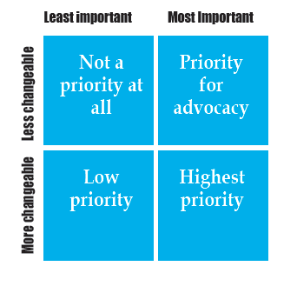
Step 3: Prioritising health issues
Ranking the health issues from highest priority actions to lowest. High priorities are considered important and easily changeable, low priorities are least important and least changeable.
Often using measuring systems like the behavioural matrix (opposite)

Slide 110
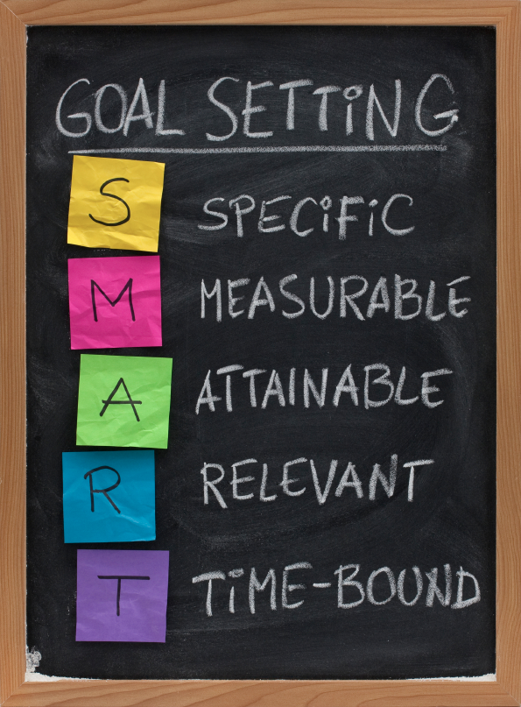
Step 4: setting goals
Setting goals to aim to achieve to meet the needs of this group.
What impact do we want to have?
What do we want to do first?
Specific – clearly and explicitly define what the issue is that you want changed.
Measureable – how will you know you have achieved it?
Achievable – can you complete this goal in the time you have with the resources you have?
Relevant – is this goal appropriate, eg respectful of diversity and culture etc
Time bound – when do you want the goals achieved by? Date.

Slide 111
Step 5: determining strategies
Planning interventions and deciding what strategies will be effective in achieving the set goals.
Are we going to focus on educational strategies? What about changing the physical environment to make it easier to address the needs of the group?

Slide 112
Step 5: developing action plans
After we have established what strategies we will be using to reach the set goals, it is time to develop a specific action plan.
This could include things like creating a specific timeline, of events, developing measurement systems and allocation of tasks to primary stakeholders.

Slide 113
Step 6: evaluating outcomes
How did we do?
Did we achieve our goals?
Measure data again and compare to baseline, measure impact of intervention.
Do the needs still exist? Are they minimalized?

Slide 114
Benefits of needs assessment
Community involvement in decision making regarding their own health
Improved communications between the public and agencies/services
More effective use of resources (money, time, effort!)

Slide 115
Application: Wace question
Answer Q27a and 27b from the 2020 WACE exam

Slide 116
references
Lockhart, E. (2011). Health Studies Stage 3A-b. Madeley: Print Publishing.

Slide 117
Ottawa charter for health promotion
Term 1
Week 7

Slide 118
Syllabus COntent
Enabling, mediating and advocating strategies in the Ottawa Charter to reduce inequities of specific groups

Slide 119
READING: health promotion & Road Safety
Use the VCE Health and Development reading from pages 281-282.
Identify one strategy in each of the 5 Ottawa charter action areas.

Slide 120
Reminder: What is health promotion?
*HEALTH PROMOTION: “Is the process of enabling people to increase control over and to improve their health” (Ottawa Charter ’86)

Slide 121
Enabling
*Enable: To empower individuals and communities to be able to do, or to be something.
To reduce health inequity health promotion needs to be aimed at reducing differences in the health statuses of specific populations by ensuring equal distribution of resources for health and equal opportunities for health.
Everyone should have equal opportunities to achieve health to their fullest potential.

Slide 122
Enabling and Health Promotion
Ensuring people have access to the information required for good health.
Allowing people to develop life skills and enabling people to make healthy choices.
Enabling is associated with improving EDUCATION and ACCESS.
“People cannot achieve their fullest health potential unless they are able to take control of the things that determine their health” (Lockhart, 2011)

Slide 123
Enabling strategies
Improving health literacy
Career advice
Education and training
Involve individuals in decision making
Delegation (giving people the opportunity to take on responsibility)- Community Development
Improving access: Health care Welfare Housing Support
Developing networks (creating supportive environments for health)
Focus on goal setting
Improving communication skills
Counselling
Mastery (achieving some success)

Slide 124
Mediating and Health Promotion
*Mediate: To act between parties with a view to reconcile differences
The responsibility of health promotion is to link individuals, groups, communities with the health sector, government and non-government organisations with the objective of reconciling the differing interests that exist within society.
People from all walks of life are to be involved in ensuring the inequity is reduced or eliminated between individuals, families and communities.

Slide 125
Mediating strategies
Holding meetings: Getting people together to talk about issues that exist Improve the lines of communication between concerning parties
Establishing rules or procedures for how things should move forward
Active listening (listening to each party that is involved and finding out what exactly it is that they need)
Empathy (trying to understand each concerned party)
Paraphrasing points of view to improve clarity
Ensuring that the concerned parties share the decision making and decide together on the solutions to the problems
Organisation of concerned parties prior to holding meetings (improving preparation for meetings)
Developing timelines for solutions and for when goals are to be met
Constructing written agreement packages and distributing them to all concerned parties
Facilitating agreements on the important issues first

Slide 126
Advocating and Health Promotion
*Advocate: To plead for a cause or an idea by raising awareness.
The aim of Health Promotion should be to reduce inequity through advocacy on behalf of those who are underprivileged or under-represented.
Advocacy should be for social, economic and personal development and the improvement of the quality of life.

Slide 127
Advocacy strategies
Awareness raising strategies
Research (identifying the causes of inequities or the issues at hand)
Holding events
Holding press conferences or debates
Notifying the media
Sending press releases inviting people to your events
Writing to politicians (lobbying)
Including the people, group or community for which you are advocating in the process
Setting goals (identifying and being clear about what you want to achieve)
Using multiple methods of communications: Internet Holding events Newsletters Advertisements

Slide 128
Application: Wace question
Complete Q29b from the 2018 WACE exam.

Slide 129
References
Lockhart, E. (2011). Health Studies Stage 3A-b. Madeley: Print Publishing.
Beaumont, A. and Fettling, M., 2018. Jacaranda Key Concepts In VCE Health & Human Development Units 3 And 4 Sixth Edition. 6th ed. Wiley & Sons Publishing, pp.291-295.

Slide 130
Actions to address health inequities
Term 1
Week 7

Slide 131
Syllabus content
Actions to address health inequity
Improving access to health care
Improving health literacy
Ottawa Charter action areas

Slide 132
Improving access to healthcare
What might this look like in general?
Think about the 5A’s (availability, affordability, adaptability, acceptability and accessibility)

Slide 133
Access to healthcare in Australia
Making sure that there are centers closer to people
making transport to health care easier and more user friendly (and parking)
making health care cheaper and more financially accessible
making health care cater for the needs of the people better.
Medicare could cover more products and services to make health care more affordable.
Rural/country towns could have more doctors and better facilities
Health care could be more culturally diverse and respect the culture and religion of all Australians
Ambulances could be cheaper and dispatched/arrive faster
Waiting times in emergency rooms and on surgery lists lessened

Slide 134
Improving health literacy
Enabling people to better understand medical and health terminology,
Empowering people to make more informed choices regarding their health
Helping people critically analyse health information.

Slide 135
Poor health literacy
Discussion question: Who tends to have poor health literacy?
LSES individuals, uneducated, homeless and socially isolated people tend to have lower health literacy.
Discussion question: What kind of impacts does poor health literacy have?
Individuals feel hopeless and out of control of their own health.
Individuals don’t know when they need healthcare (not able to understand symptoms) or how to access appropriate healthcare.
Increases chance of disease and comorbidities.

Slide 136
Good health literacy
Discussion question: Who tends to have good health literacy?
Highly educated, high SES individuals and communities.
Discussion question: What kind of impacts does good health literacy have?
Individuals feel in control of their health.
Individuals can make better decisions regarding their health
Individuals can follow health plans
They can recognise when they need help and know how to access appropriate healthcare.

Slide 137
View & reading
Watch the 2 min video below, then complete the reading.
https://www.sbs.com.au/news/insight/how-literacy-classes-have-transformed-a-town
Read the article at:
https://theconversation.com/to-lift-literacy-levels-among-indigenous-children-their-parents-literacy-skills-must-be-improved-first-78827
How is this adult literacy program working to improve health literacy?
(Consider the health literacy of both adults and their children.)

Slide 138
Ottawa Charter Action Areas
Together the 5 action areas form a comprehensive health promotion strategy or program. Interventions should include one action from each action area; develop personal skills, re-orient health services, create supportive environments, strengthen community action and build healthy public policy.
Much health inequity is out of the control of the individual. Environmental factors keep people experiencing poor health. Ottawa charter action areas help change the environment and thus allow the individual to take control of their own health. By making healthy public policy and creating supportive environments and re-orienting health services allow the individual to experience better health.

Slide 139
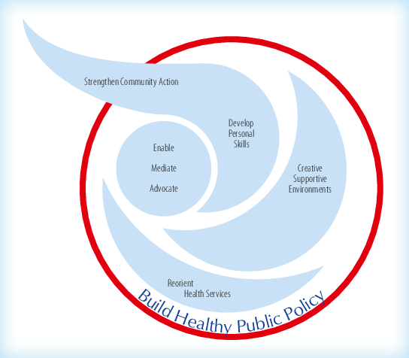
The logo/emblem for Health Promotion
(as designed by the World Health Organisation)
Use the WHO site to describe the components of the logo and what they represent/how they are arranged.
https://www.who.int/teams/health-promotion/enhanced-wellbeing/first-global-conference/emblem

Slide 140
HEALTH INQUIRY 1
Term 1
Week 8-9

Slide 141
Culture and decision-making
Term 2
Week 1

Slide 142
SYLLABUS CONTENT
Influence of culture on personal beliefs, attitudes and values towards healthcare
Conflict between norms of specific groups and majority norms
Influence of environmental factors on the health behaviour of cultural groups
geographical location
Social networks
Language and Cultural influences on relationship building in health settings
Impact of culture on health decision making
Organ and tissue donation
Blood transfusions
Childbirth

Slide 143
definitions
Norm: Customs and values which both guide behavior and act as a framework from which behavior is judged by the majority.
Majority norm: Unwritten rules or standards that more than 50% of the population or community believe in or obey.
Norms of specific groups: Social or cultural norms that are unique to a particular group of people within a population.
Proscriptive norms: Norms that ‘prohibit’ you from doing something. A behavior you should not do.
Prescriptive norms: Norms that ‘prescribe’ behavior, so they make you do something. A behavior you should do.
Popular norms: Norms made by people who are considered popular or who hold power. Fashionable norms or ‘trends of the day’. Popular norms are followed by people who are or want to be perceived as trendy or “in”.

Slide 144
Decision making?
Consider the following questions:
What factors influence you when you are making decisions?
Are the factors influencing the decisions that a persons make the same for everyone?
Why do we consider different factors when we make decisions?
**Our culture has a significant impact on our decision making on health related issues.

Slide 145
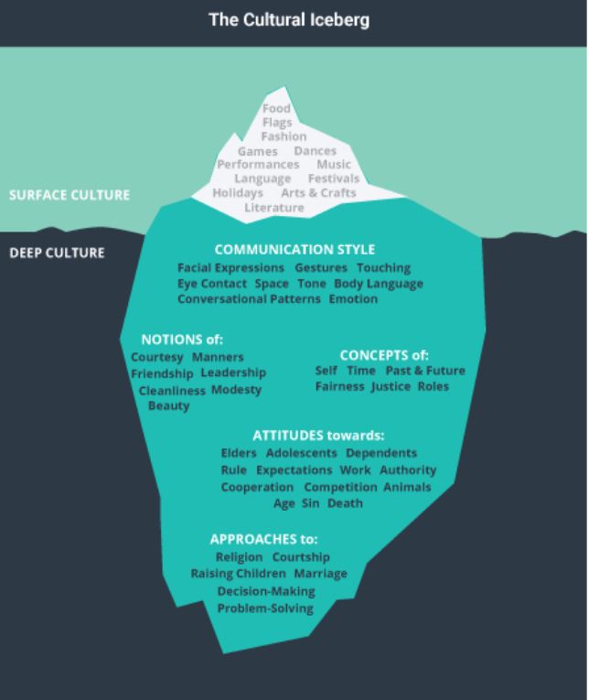
Let’s talk about culture:
Culture is defined as the beliefs, behaviours, objects, ideas, customs, social behaviour and characteristics common to the members of a particular group or society.
Have a look at the “surface” and “deep” elements of culture opposite.
How does your culture impact the way you view these things? How does that differ from others in the class?

Slide 146
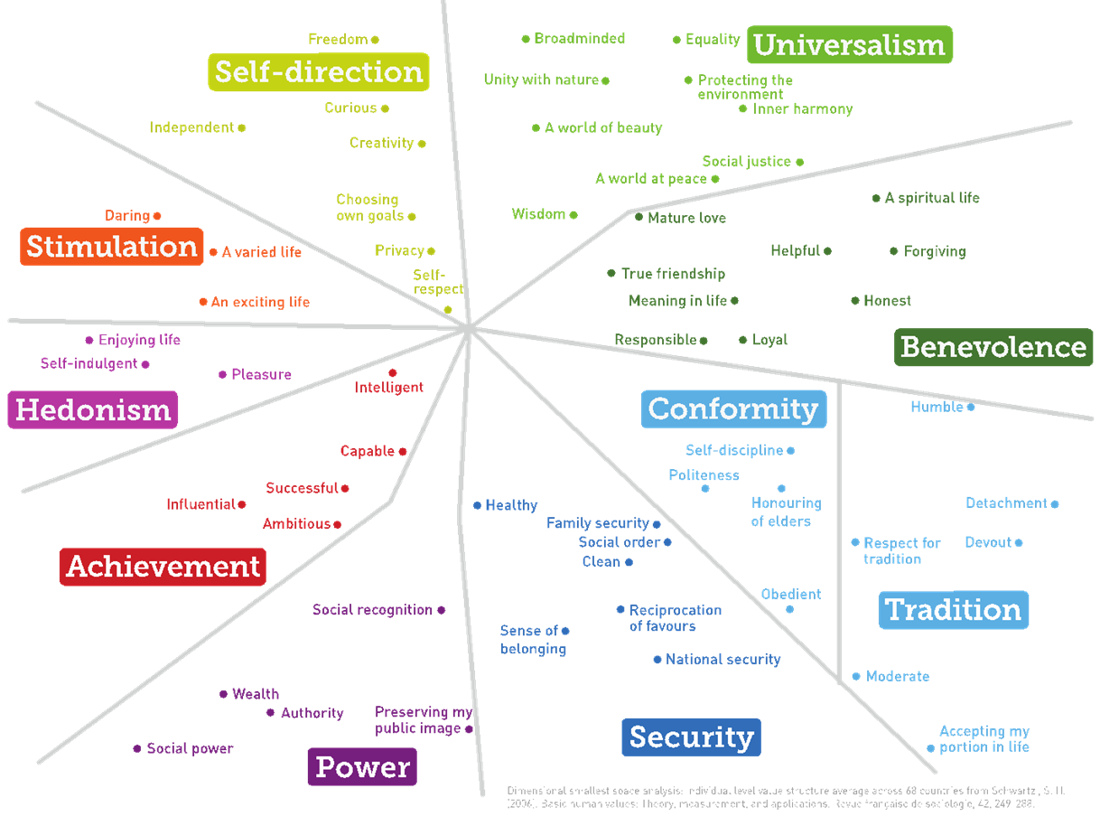
Let’s talk about values:
One particularly interesting and prominent theory regarding VALUES is from Shalom Schwartz, who proposes that there are 10 broad value domains that are universal and fairly comprehensive:
Which values drive YOUR behaviour and decision making?

Slide 147
Culture and Beliefs
How can one’s culture influence their beliefs about healthcare?
Cultural upbringing influences our beliefs.
Beliefs are usually passed down through generations. (the way we are treated as young children influences our beliefs about healthcare and is often similar to how we treat ourselves and others later in life)
CLASS DISCUSSION: How did your family behave in the following areas?
Use of sunscreen
medicine
exercise
diet choices
injury management

Slide 148
Culture and values
How can one’s culture influence their values about healthcare?
Values in a culture are unlikely to change. (less likely that beliefs and attitudes)
Values are “expressions of, or beliefs in, the worth of objects, qualities, or behaviours. They are typically expressed in terms of goodness or desirability or, conversely, in terms of badness or avoidance. They often invoke feelings, define or direct us to goals, frame our attitudes, and provide standards against which the behaviours of individuals and societies can be judged.”
(Kates, Parris & Leiserowitz, 2005, p. 16)

Slide 149
Australian values:
Freedom of speech
Democracy
Equality (across all areas)
a “fair go”
How would these values translate into a healthcare setting?

Slide 150
Culture and attitudes
How can one’s culture influence their attitude towards healthcare?
(attitude: positive or negative feelings towards people, objects and things)
Attitudes result from beliefs and values

Slide 151
Conflicting norms
We are going to explore the conflict between norms of specific groups and majority norms.
Consider some of the norms that can be influenced by culture…
Naming systems and greetings
Differences in how certain family members are perceived (kinship and hierarchy)
Difference in appearance and priorities of appearance
Communication styles

Slide 152
Conflicting norms
When the majority norm encourages one behaviour, and the norm of the specific group encourages a different behaviour, what is the outcome?
Division?
Embarrassment?
Conflict?
Discrimination?
Which behaviour will they choose? How will this influence their health?

Slide 153
Influence of Environmental factors
Influence of environmental factors on the health behaviour of cultural groups
The two environmental factors we look at are:
Geographical location
Social networks

Slide 154
Geographical Location
Disease occurs in patterns based on geographical location.
For example, cardiovascular disease is more prevalent in first world countries. (cardiovascular disease is non-communicable so it isn’t transferring from one person to another)
The physical environmental factors influence the norms in the cultural groups that live in those areas and therefore influence health behaviours.
Consider walkability, urban sprawl and number of fast food places.

Slide 155
Social networks
Social networks can work positively or negatively.
“Close-knit social networks promote information transfer.”
How can this improve health?
If people discuss the promotion of physical activity and the harms of alcohol abuse then people in that network are less likely to engage in those behaviours.
How can this reduce health?
If people discuss excessive alcohol consumption in a positive way (ie. “funny drunk stories”) and promote unhealthy food consumption and sedentary lifestyles then the people in that network are more likely to engage in these unhealthy behaviours.
“Social networks provide social support”
How can this improve health?
mental wellbeing and social health, increased confidence and self esteem. Can it improve physical health??
TED TALK: The hidden influence of social networks https://www.ted.com/talks/nicholas_christakis_the_hidden_influence_of_social_networks?language=en

Slide 156
Social networks & health behaviours
Complete Q24a from the 2020 WACE exam.

Slide 157
Childbirth, organ donation & Blood TranSfusions
Task:
Identify cultural influences on each of the three health behaviours above.
Consider the following questions:
Is this procedure considered acceptable in different cultures?
Who can and can’t participate in these procedures?
Are men and women treated equally within these cultures?
What factors are present within these cultures that contribute to the decision to participate or not participate in these procedures?
Identify differences and similarities between cultures.

Slide 158
Let’s get personal…
What are your beliefs, attitudes and values specific to these three procedures?
Identify where you think these BVA’s come from?

Slide 159
Case study: transplants in australia
Australian culture
We value altruism: The belief in or practice of selfless concern for the well-being of others, behaviours that benefit others at their own expense. (think ANZACs)
Many Australians have the belief that by donating their organs that they will save lives.
The combination of these values and beliefs may lead to Australians registering to donate their organs or agreeing to donate the organs of a loved one.
Indigenous Australian culture
Value spirit and tradition. Have a need for the body to be buried whole so that the spirit can move.
These beliefs and values may influence and indigenous Australian to not register as an organ donor.

Slide 160
Why is this important?
A large aspect of health care involves working and communicating with a variety of people.
These relationships require trust and cooperation to be effective
Health settings include (but are not limited to!)
School nurse
Nurse in a hospital ward
Health worker in a prison
Child health centre
Aged care homes
Sports first aid or trainer
Can you think of any more?

Slide 161
Barriers to effective relationships in healthcare
Negative past experiences such as discrimination and racism at healthcare centers.
Communication difficulties such as language differences and health literacy.
Lack of established networks within a community.
Mental illness such as PSTD or anxiety can make it difficult for patients to express themselves
Health professionals treating patients as objects rather than people (e.g. just the hard facts, no emotional involvement or attempt to understand the patients situation)
Patients developing a lack of trust in the healthcare professional (for a variety of reasons)

Slide 162
What skills do health professionals require to overcome these barriers?
Assertiveness
Active listening
High level of emotional intelligence
Clinical empathy
Self reflection

Slide 163
In a practical sense, How can health professionals overcome these barriers?
Increase training for health professionals on how they can implement a range of communication skills into their work.
Upskills health professionals to be able to tell the patient courteously what they require for the relationship to be effective.
Provide strategies for health professionals to overcome language barriers by all means necessary (ie. Human translator, google translate, involving family members etc).
Role play difficult scenarios so health professionals can practice being assertive, mindful and emotionally intelligent to best understand the patient and the factors that are influencing their health

Slide 164
Let’s look specifically at Language, culture and relationship building…
Barriers to effective relationships when the patient/healthcare professional come from different backgrounds?
Not speaking the same language can mean conversations about plans are not understood and may lead to misinterpretation of information.
Differing levels of Health literacy may impact understanding of the terminology that is used. (patient feels confused, overwhelmed or stupid)
People can be offended without the health care provider realizing it (due to lack of understanding about the persons culture-ignorance)
Conflicts and arguments may arise as a result of the use of some treatments or procedures that don’t work with some cultures.

Slide 165
Let’s look specifically at Language, culture and relationship building…
How can health professionals overcome these barriers?
Using translators to overcome language barriers
Using simple language (no jargon) and checking for understanding between each instruction. (e.g. asking the patient to explain it back to them)
Writing things down for the patient to take home and process at their own pace
Increase cultural awareness through training
Using shared decision-making models to include patients in the decision-making process.

Slide 166
Example
https://www.safetyandquality.gov.au/sites/default/files/migrated/Final-Report-Patient-Clinician-Communication-Literature-Review-Feb-2013.pdf
In a report prepared for the Australian Commission on Safety & Quality in Health Care by the Centre for Health Communication, UTS makes some interesting findings:
It explores effective healthcare communication in three aspects:
1. Communication needs to be a structured process engaged in by clinicians with identifiable communication skills and knowledge that can be taught and measured.
2. Communication needs to be attentive or mindful whereby the clinician enables the patient to express their concerns, needs and preferences, and this leads to better diagnostic processes and treatment outcomes with process integrity.
3. Communication is a non‐linear, unpredictable process steeped in uncertainty (patients have unique needs, views and preferences and are likely to present with chronic disease potentially complicated by co‐morbidities; the clinician is part of a complex team of professionals whose knowledge about the patient is dependent on a variety of sources.

Slide 167
Application activity
Annotate on the following case study where you see barriers to effective communication between Beth and her healthcare professionals. Note how each would make Beth feel and if applicable, how the healthcare professionals could improve their communication with Beth.

Slide 168
Beth Case study (60 year old Female)
Beth visits her local hospital’s emergency department (‘ED’) because she is having increasing difficulty breathing. She has been referred by her GP and arrives with his referral letter. The triage nurse establishes quickly that Beth needs to be seen by a doctor and arranges an emergency ward bed for her. Before Beth is taken to her bed, a paramedic who is doing extended care paramedic training does a special blood gas test on her.
Once Beth is in her bed, a junior nurse arrives. A new graduate, the nurse’s nerves show as he asks in rather robotic fashion for Beth’s full name and her date of birth. He then leaves to collect an armband for Beth. When he returns, he repeats the questions he just asked of her, and again does so in quite a mechanical way. He is unable to establish interpersonal contact with his patient. He leaves, and a junior doctor arrives.
An hour after Beth’s arrival on the ward, a second more experienced nurse arrives to arrange an ECG. He is followed by a junior doctor. The junior doctor introduces himself to Beth, identifies as one of the doctors in the hospital, and then begins the consultation:

Slide 169

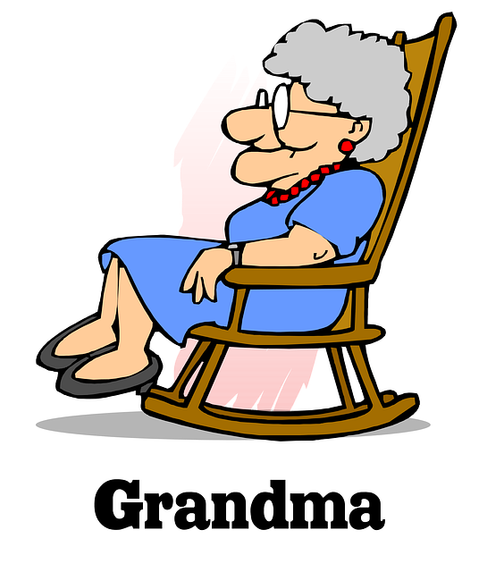
Ooh oh everything!
Well the oxygen drop is was what the GP was worried about and oh coughing and I have been a smoker I’m not denying it but ever since ((chuckles)) I had the Vibramycin
I’ve it seems to have got rid of everything in the nose and my mouth and my lungs coughing stuff up but I’m not having not coughing enough up I can’t seem to get it up so there’s something obviously I need a bomb under me
No
Ah well the last couple of nights I’ve had nightsweats actually.
Very sweaty
And um I’ve been too tired to get out of bed and I was nearly gonna get out and have a shower then I thought ‘No I’ll get a chill’
What’s been going on?
Okay… Anything in particular?
Yeah
Sure. besides the trouble with the breathing like not being able to get your breath what are the other problems sort of have you got no energy have you had temperatures?
Sweats?
Okay.
Yup
Okay.
This Photo by Unknown Author is licensed under CC BY-SA

Slide 170
Beth Case study 60 year old Female
In a very matter of fact way, the junior doctor gathers the information he needs to diagnose Beth’s problem. Beth explains to him that she has had a couple of night sweats recently, and is finding that she is getting very tired doing basic things like having a shower and walking up the stairs. In the last few days she has also been nauseous, is sore in the nose and has gone off her food and has diarrhoea. She also suffers from irritable bowel syndrome and she has been having oxygen at home to help her breathe. His questions are focused on clinical matters, and he spends little time on ‘niceties’. He leaves shortly after.
Over the next nine hours, Beth is visited by three more nurses and one other doctor. This second doctor asks Beth many of the questions that have already been asked of her: what are her medications? and what is her exercise capacity like? As a trained Assistant In Nursing, Beth is able to give good answers to these questions. She is very engaged in the consultation and asks quite a few pertinent questions of the clinicians. At one point she also self‐ diagnoses: “So I mean I don’t think that’s [a pain in her side] anything to do with this [her difficulty in breathing]”. Although her knowledge is a help in particular to the junior doctor, her signs and symptoms present him with uncertainty. At one point, the junior doctor gets confused about what she has already told him about her history. He says: “But did you say that [already]? I’m just trying – I’m getting my patients mixed up!”

Slide 171
APPLICATION QUESTION
Complete Q24 from the 2018 WACE exam

Slide 172
references
Lockhart, E. (2011). Health Studies Stage 3A-b. Madeley: Print Publishing.
Iedema, R. and Manidis, M. (2013) Patient‐Clinician Communication: An Overview of Relevant Research and Policy Literatures. Sydney: Australian Commission on Safety and Quality in Health Care and UTS Centre for Health Communication.

Slide 173
Skills that support positive health behaviours
Term 2
Week 2

Slide 174
Syllabus content
Skills that support positive health behaviours
Assertiveness
Stress management
Resilience
Relationship between health literacy and health status

Slide 175
3 main skills we are focusing on:
1. Assertiveness
2. Stress management
3. Resilience

Slide 176
Assertiveness
*Assertiveness is a communication style in which your communication allows you to accurately express your needs, concerns and opinions whilst being respectful towards others.
How does assertiveness support positive health behaviours?
Individuals can assertively communicate with health professionals what they need.
Individuals who can communicate assertively can refuse negative health behaviours when offered. (eg tobacco, alcohol, illicit drugs)

Slide 177
Stress management
*Stress-management is a set of techniques and programs intended to help people deal more effectively with stress in their lives by analysing the specific stressors and taking positive actions to minimize their effects.
Evidence based stress management techniques include organisational skills, yoga, meditation and mindfulness practices and effective sleep routines.
How can stress management support positive health behaviours?
Individuals can manage stressful situations effectively and maintain good health.
Individuals can recognise symptoms and stress and plan accordingly.
Effective stress management helps individuals to use their time and energy in a way that fosters positive health outcomes.
Allows for individuals to survive during difficult periods of life

Slide 178
resilience
*Resiliency is the ability to bounce back after challenging, difficult times. It is the ability to endure when faced with adversity.
How can resiliency support positive health behaviours?
Individuals can persevere when things don’t go as planned or if they get negative reactions from the decisions that they have made.
It helps them to cope with adversity/stress/catastrophe and maintain good physical and mental health.

Slide 179
Components of resiliency
Cognitive and behavioural factors (include problem solving and analytical skills, optimism, self esteem)
Social and contextual factors (include relationships, access to services and other environmental factors)
Genetic factors (include gender, temperament, intelligence. Girls and children with easy going temperaments tend to be more resilient, as do children with higher intelligence)

Slide 180
How to build resiliency: podcast
Listen to the following podcast:
https://www.rickhanson.net/well-podcast-introducing-resilience/
(15 mins)
How can we grow our resilience?

Slide 181
How to develop resiliency:
Practice optimism
Positive self talk
Learn to use humour appropriately
Developing coping skills through experience-trial different strategies to overcome struggles.
Add to your list here from the podcast!!

Slide 182
Health literacy
*Health literacy is an individuals knowledge, motivation and competence to access, read, understand and apply health information in order to maintain and improve health outcomes.

Slide 183
What do we already know?
Individuals with higher level of health literacy tend to have a better health status.
HEALTH = HEALTH
LITERACY HEALTH STATUS
We are going to elaborate…and include WHY in our answers.

Slide 184
Last years levels of health literacy…
Last year we looked at health literacy in three capacities:
1. Functional Health Literacy
2. Interactive Health Literacy
3. Critical Health Literacy
Let’s move forward into this years syllabus

Slide 185
3 Levels of health literacy
Level 1: Functional Health Literacy
Level 2: Conceptual Health Literacy
Level 3: Health Literacy as Empowerment

Slide 186
Functional Health Literacy
A set of “generic skills” applied in a healthcare environment.
What are some examples of these “generic skills”?
Read consent forms
Read and follow medicinal instructions
Understand verbal/written instructions given by health professionals
Engaging in a series of simple self-care strategies
Making medical appointments

Slide 187
Conceptual health literacy
A multidimensional approach that links generic skills with technical and cultural knowledge.
This technical/cultural knowledge gives meaning to the generic skills.
Individuals at this level of health literacy have a wide range of skills/competencies including things like:
Seek, comprehend, evaluate, be critical and use health information.
These individuals can make informed decisions, reduce health risks and increase QOL in a range of contexts; science, culture, technology and media.

Slide 188
Health literacy as empowerment
Focuses on the interaction between LITERACY and POWER.
Suggests that literacy is an exchange between less and more powerful individuals, institutions and political contexts.
Strengthens active citizenship for health in the following areas:
Allowing individuals to understand their rights as patients in the healthcare system
Acting as informed consumers of health products and services
Allowing individuals to improve health through the political system (voting, advocacy and memberships in social movements)

Slide 189
Who tends to experience poor health literacy?
Population groups most likely to exhibit low health literacy levels include:
Elderly people
Ethnic minorities
People with low levels of formal education
Low income earners (lower socioeconomic people groups)

Slide 190
Poor health literacy & Health status
Poor health literacy leads to:
Increased experience of chronic diseases
Higher rates of hospitalisation
Increased hardships that are linked to poor health outcomes
Increased mortality rates
Experience more drug and treatment errors
Make less use of preventative services
Poorer self management skills

Slide 191
Who tends to experience good health literacy?
Population groups most likely to exhibit high health literacy levels include:
Individuals who are highly educated (individuals with tertiary education)
Individuals who work in the health industry
Individuals in metropolitan areas

Slide 192
good health literacy & Health status
Good health literacy leads to:
Reduced experience of chronic diseases
Lower rates of hospitalisation
Reduced mortality rates
Experience fewer drug and treatment errors
Make more use of preventative services such as screening and immunisation
Better self management skills

Slide 193
Practise Multiple choice question
Health literacy is a critical skill, even for those who already possess advanced literacy skills. This is because
(a) health literacy skills need to be practised to be retained.
(b) health literacy skills generally decline with age.
(c) accurate and reliable health information is difficult to find.
(d) health information may become outdated or forgotten.
Answer: D

Slide 194
CLAss activity: exam writing
You need to design a question for a future WACE exam to assess the students understanding of the relationship between health literacy and health status.
You need to create an example, (a short case study) and assess both surface level understanding and deep level understanding. (ideally 5-10 marks)
Create your question on a word document page with line allocations ☺
On the second word document page, you need to create a marking key!
Send it to me via direct message when you are finished.

Slide 195
Sources:
Lockhart, E. (2015) Health Studies Year 12 ATAR.

Slide 196
State and Federal health reforms
Term 2
Week 3

Slide 197
Syllabus content
Healthcare system reforms
Private health insurance rebate
Public screening and/or vaccination programs
Pharmaceutical Benefits Scheme (PBS)

Slide 198
reading
Read the following overview prior to this content:
https://www.aihw.gov.au/reports/australias-health/health-system-overview

Slide 199
Australia’s health system: an Overview
AIHW, 2018
“A person is likely to use the health system in various ways throughout their life. This pattern reflects their health needs at different life stages, the social and environmental impacts on their health, and personal circumstances. Some people may visit a pharmacy or general practitioner (GP) infrequently; some may have regular appointments with a GP, specialists or other health practitioners; others may need to go to hospital for tests, treatments or emergencies.
The World Health Organization describes a good health system as one that ‘delivers quality services to all people, when and where they need them’ (WHO 2018). Australia’s health system is a complex mix of health professionals and service providers from a range of organisations—from all levels of government and the non-government sector. Collectively, they work to meet the health care needs of all Australians. Health services are delivered in numerous ways and settings, including through health promotion and education programs, diagnosis, treatment and preventive services in the community, treatment and care in hospitals, rehabilitation in hospitals and the community, and palliative care.
A variety of organisations support these services. Health departments and other government agencies are responsible for policy and service planning. Research and statistical organisations collect and publish information on health conditions and issues (including monitoring, assessing, evaluating and reporting). Universities and health services train health professionals. Consumer and advocacy groups have a role in public debates on health policy and regulation. Voluntary and community organisations support health service functions through activities such as fundraising for research and raising awareness of health issues through education programs.”

Slide 200
MEDICARE: an Overview
Australia’s health system is underpinned by Medicare—a universal public health insurance scheme. Medicare is funded by the Australian Government through general taxation revenue and a 2% Medicare levy (ATO 2017a; Biggs 2016a).
Intergovernmental agreements for public hospital funding between the Australian Government and state and territory governments guarantee Medicare cardholders access to fee-free treatment as public patients in public hospitals (Boxall 2014).
Medicare also covers a portion of the Medicare Benefits Schedule fee for medical services and procedures, and Medicare cardholders have access to a range of prescription pharmaceuticals subsidised under the Pharmaceutical Benefits Scheme (Biggs 2016a; Department of Health 2018; DHS 2017a).

Slide 201
MEDICARE: an Overview continued
Some medical and allied health services are not subsidised through Medicare. For example, Medicare does not usually cover costs for ambulance services, most dental examinations and treatments, physiotherapy and optical aids (such as glasses and contact lenses).
Not everyone in Australia can access Medicare. Currently, it is available only to Australian and New Zealand citizens, permanent residents in Australia, and people from countries with reciprocal agreements (DHS 2017b, 2017c). Most people outside these categories have to pay full fees for health services or take out private health insurance (PrivateHealth 2017c).

Slide 202
Public vs private health systems
In Australia, Medicare provides universal health insurance that delivers affordable, accessible and high-quality health care for most Australian residents (Public system).
Who is eligible for Medicare? People who live in Australia or on Norfolk Island and meet certain criteria. (ie citizenship or residency status etc)
However, you can also choose to take out private health insurance to give you more health care options and to cover items which are not covered by Medicare. (private system)
https://www.humanservices.gov.au/individuals/services/medicare/medicare-card/eligibility/who-can-get-it

Slide 203
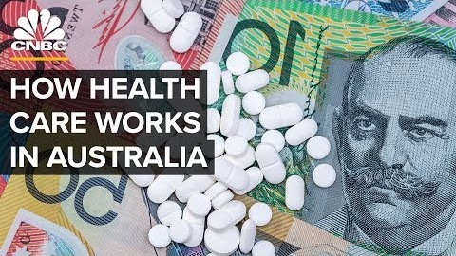

Slide 204
Healthcare reform #1: Private health insurance rebate
Let’s start with what private health insurance is:
“There are two types of private health insurance - hospital policies cover you when you go to hospital, while general treatment policies (sometimes known as ancillary or extras) cover you for ancillary treatment (e.g dental, physiotherapy). Most health funds offer combined policies that provide a packaged cover for both hospital and general treatment services, or you can buy separate hospital and general treatment policies to 'mix and match'.”
-Department of Health

Slide 205
How does private health insurance work?
Individuals choose a company/premium that suits their requirements.
Individuals can choose to pay either weekly/monthly/annually (etc) premiums.
Individuals then pay less or none on the spot for particular health services.
Insurers cannot refuse to insure someone and they must charge all individuals the same price for the same level of insurance. (despite their differing risk levels of likelihood of using their insurance)
Generally, more expensive insurance policies cover a wider range of services, and cheaper insurance policies cover less services.
As of April 2020, a four-tier program is in place and all hospital insurance policies will be either GOLD, SILVER, BRONZE or BASIC. This is designed to make the hospital insurance policies easier to navigate.

Slide 206
Private health insurance
The biggest health insurance companies in Australia?
Medibank: 26.9% market share.
Bupa: 26.9% market share.
HCF: 10.4% market share.
nib: 8.3% market share.
HBF: 8% market share.
How many Australians have private health insurance?
As at June 2017, 11.3 million Australians (46% of the population) had some form of private patient hospital cover, and 13.5 million (55%) had some form of general treatment cover (APRA 2017)

Slide 207
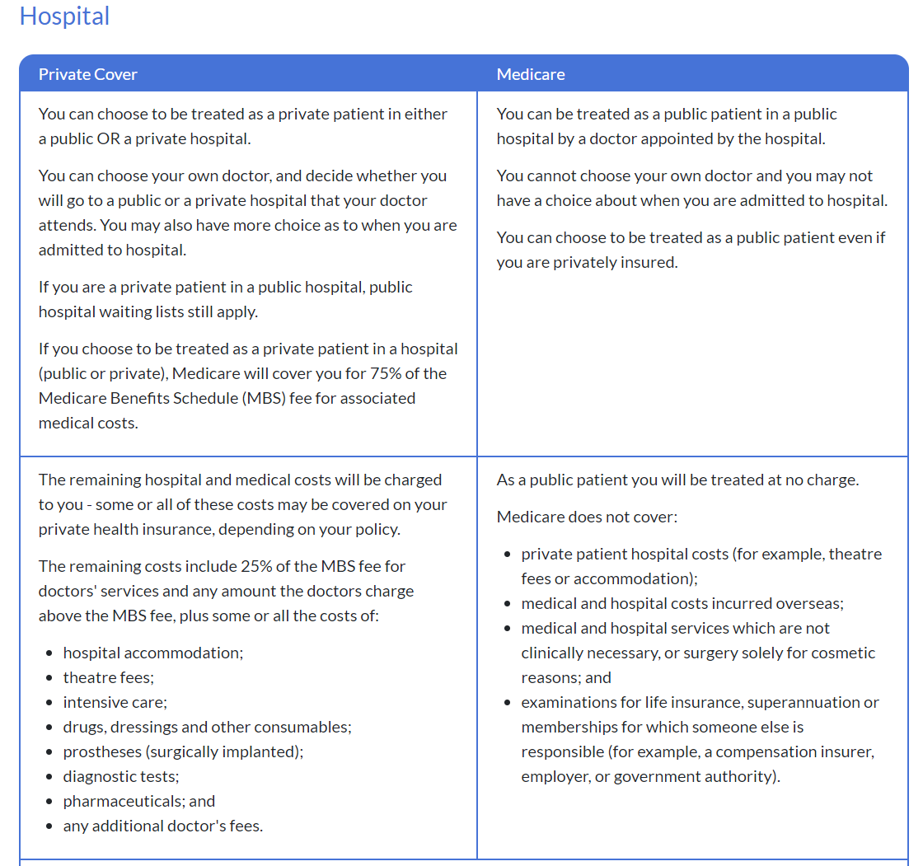
https://www.privatehealth.gov.au/health_insurance/what_is_covered/index.htm

Slide 208
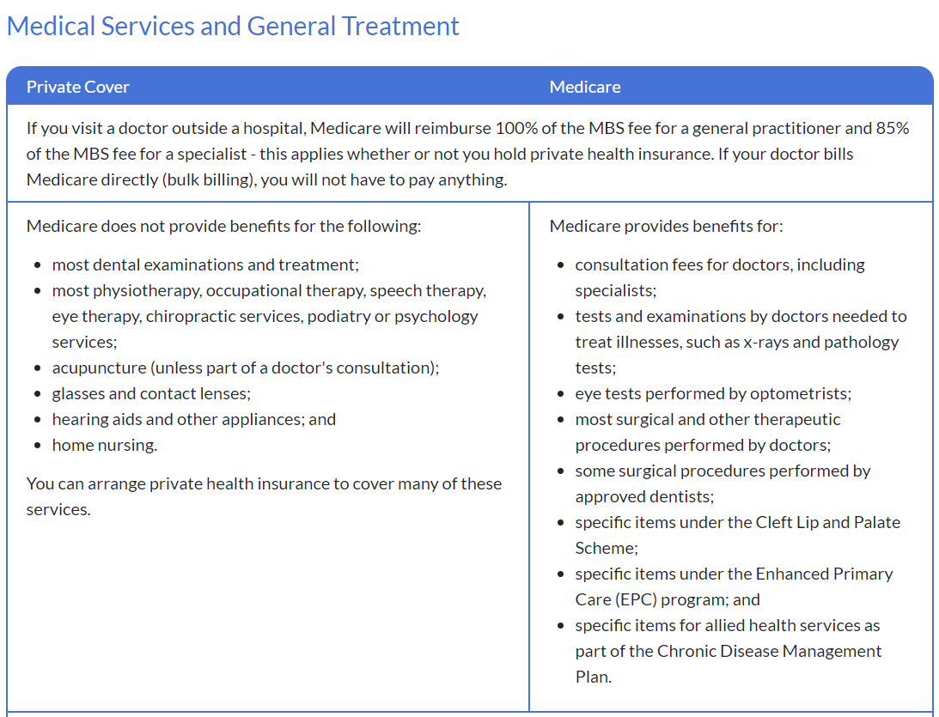

Slide 209
Let’s talk about the rebate…
The following information comes from the Australian Taxation Office (ATO)
“The private health insurance rebate is an amount the government contributes towards the cost of your private health insurance premiums.
The rebate is income tested which means your eligibility to receive it depends on your income. (If you have a higher income, your rebate entitlement may be reduced, or you may not be entitled to any rebate at all.)
The rebate can be claimed for premiums paid for a private health insurance policy that provides private patient hospital cover, general cover (commonly known as extras), or combined hospital and general cover.

Slide 210
Let’s talk about the rebate…
If you or your family don't have an appropriate level of private patient hospital cover , and your income for Medicare Levy Surcharge (MLS) purposes is above a certain threshold, you may be required to pay the MLS. The rate of MLS depends on your income for MLS purposes. This applies unless you (and your dependents if you have them) are exempt from paying the Medicare levy.
You can claim the private health insurance rebate as a reduction in the amount of private health insurance premiums you pay to your insurer. Alternatively, we will calculate your private health insurance rebate when you lodge your tax return. This rebate is a refundable tax offset.
The rebate percentage is adjusted on 1 April each year.

Slide 211
Advantages of Private health insurance:
Choice of health professionals. (doctor, surgeons etc)
Can get cover for many services that are not covered by medicare
Shorter waiting times (ie surgery)
It gives peace of mind that expensive health issues won’t send you bankrupt

Slide 212
Disadvantages of private health insurance:
It is an extra financial cost, and not cheap.
It is therefore not really available for low income earners
There are many companies and their information can be difficult to navigate and understand.

Slide 213
Class activitY
Imagine that you are moving out of home and require getting your own private health insurance. Do some research online, and find a company and policy that could work for you with your needs.
How much would you pay per month?
What would be covered?

Slide 214
Pharmaceutical benefit scheme (PBS)
https://www.youtube.com/watch?v=hqtV_l2XQz8&feature=emb_logo
(2 min overview of the PBS)

Slide 215
Healthcare reform #2: Pharmaceutical benefits scheme
What is the PBS?
Began in 1948! (very limited back then)
Government subsidies the cost of certain medicines on an approved list.
Pharmaceutical companies must agree to not overcharge for the medicine. (protecting the public from inflation by pharmaceutical companies)
Making medicine more available for all Australians. (based on social justice model)
Additional concessions for those with low income and a safety net for those with ongoing illnesses (once a certain amount has been paid in a year the person can get their PBS medication free for the rest of that year).
Approved list is constantly reviewed and updated on the first day of every month.

Slide 216
Who is eligible for Pbs?
All Australian Residents who hold a current Medicare card are eligible to receive benefits under the PBS.
The Australian Government has also set up a Reciprocal Health Care Agreement (RHCA) with certain countries, designed to give visitors from particular countries the benefits of the PBS. (New Zealand, the United Kingdom, the Republic of Ireland, the Netherlands, Finland, Sweden, Norway, Malta, and Italy.)-show passport!
Within the PBS, there are two levels: General and Concessional. This status will determine which co-payment level you are required to pay for PBS prescriptions.
Concessions include: Pensioner Concession Card, Australian Seniors Health Card, Health Care Card, Department of Veterans' Affairs (DVA) Gold, Orange, or White Card

Slide 217
Advantages of PBS:
Provides free or subsidised medicines for vulnerable groups in the community who may not be able to afford them
Removes barrier of cost to accessing medicines
Access to necessary medicines can reduce incidence of hospitalisation and associated costs, therefore placing less burden on health care resources
Governments can bargain more effectively on behalf of consumers to ensure that newly patented medications are made available at more favourable prices
Data from PBS medications provides data for governments with respect to types of medications, quantity, dose and strength being dispensed

Slide 218
Disadvantages of PBS:
Ageing populations may place pressure on governments to provide more medications as part of the scheme, thereby increasing government expenditure and creating dependency model
Not all medications are available on the PBS - not a totally equitable situation for consumers requiring medication/s which do not sit within the scheme
Chronic conditions often require medication over a long period of time which is costly for governments
Growth in the scheme (i.e. provision of more medications) and dependence on subsidized/ free products places pressure on limited government health resources
It can be difficult to delist medicines, as consumers may rely on these to manage chronic conditions. Delisting to provide for growth in the scheme, is not always a popular option.

Slide 219
Healthcare reform #3: PUBLIC screening/ vaccination programs
What are Public screening/vaccination programs?
The Australian Government funds a large number of screening and vaccination programs.

Slide 220
Public screening programs
RECAP: What is screening?
Checking healthy populations for signs/symptoms of disease
Secondary level of prevention
Early detection!
Allows for treatment before the disease gets worse. (saves health resources)
To be considered for screening the disease must be easily detected at early onset and must be able to be easily treated with a high chance of survival and cure.
Public screening in Australia include: bowel cancer, breast cancer, cervical cancer, scoliosis and high blood pressure. (but are not limited to!)

Slide 221
Advantages of public screening programs:
Reduces cost of treatments by early detection
Increases the likelihood of people getting screened if it is free
Reduces pressure on the health system in Australia

Slide 222
Disadvantages of public screening programs:
It still depends on the individuals desire to get screened.
Often disadvantaged groups have reduced access which creates inequities
It relies on education and health literacy levels
Some individuals cannot get immunised due to allergys/immune issues

Slide 223
Public health vaccination programs
Government funded vaccination programs
Vaccinations provided to everyone in a population to immunize against disease.
Reduce the risk and spread of disease.
Limiting the need for ongoing treatment for conditions that are vaccinated against.
The list of immunisations available is always changing with advancement in science.
Why is herd immunity/community immunity so important?

Slide 224
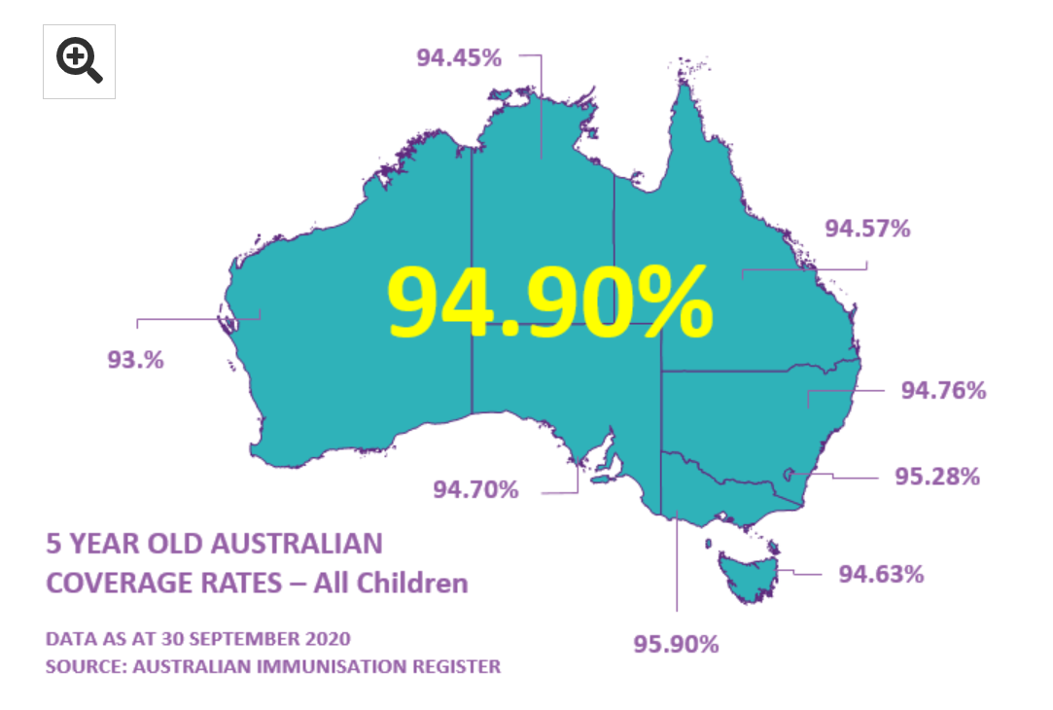
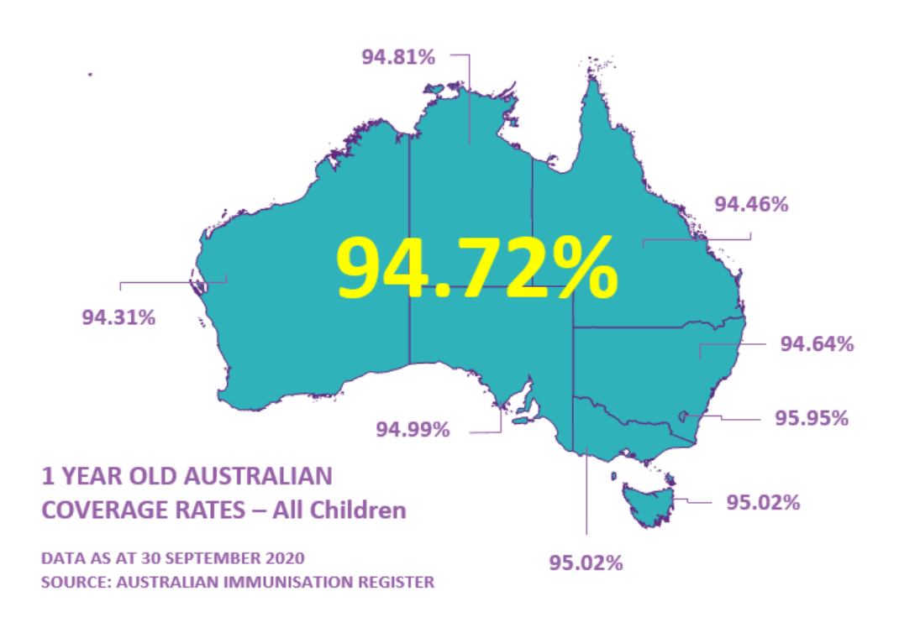

Slide 225
The impact of immunisation in Australia
The first vaccinations occurred in 1932.
Immunisation in Australia is considered to be the “most significant public health intervention in the last 200 years” –Department of Health
“Deaths from vaccine-preventable diseases have fallen by 99 per cent, despite a threefold increase in the Australian population.”- Department of Health

Slide 226
The National immunization program (NIP)
“The NIP provides free vaccines against 17 diseases for eligible people.”
“Since July 2017, the Australian Government has provided ongoing access to free catch up vaccines equivalent to those received in early childhood for all young people up to the age of 19 years and refugees and humanitarian entrants of any age.”
“Families’ eligibility to receive family assistance payments, such as Family Tax Benefit and Child Care Subsidy, is linked to their child’s immunisation status. Only families who fully immunise their children, are on a recognised immunisation catch-up schedule, or have an approved medical exemption can receive those family assistance payments. Vaccination objection will no longer be a valid exemption.”
**Read the OPINION PIECE “No Jab, No Pay” from the West Australian

Slide 227
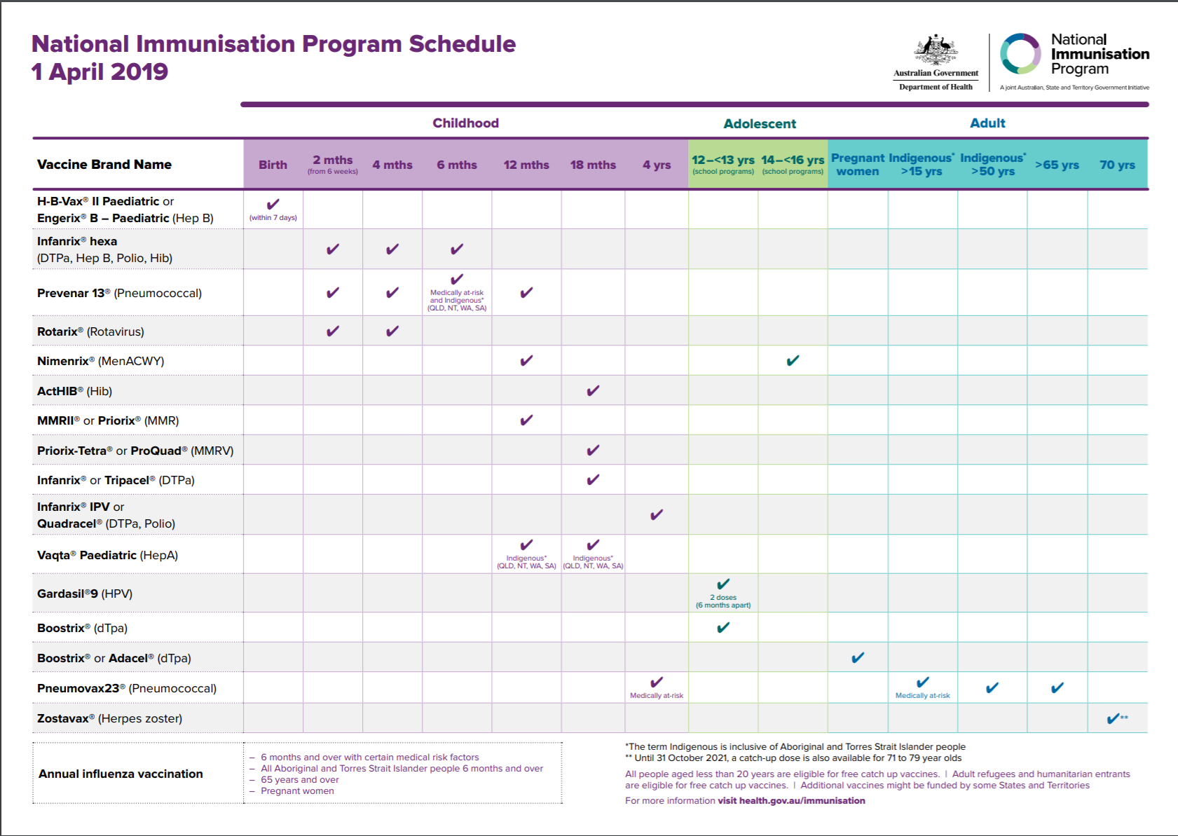

Slide 228
https://beta.health.gov.au/health-topics/immunisation/immunisation-throughout-life/national-immunisation-program-schedule
Use the above link to look at what diseases are covered with each vaccine.

Slide 229
Measles – Elimination Achieved in Australia
http://www.health.gov.au/internet/main/publishing.nsf/Content/ohp-measles-elim-announce-2014.htm
Read the above article.

Slide 230
Herd immunity
The percentage of people required to be immunized to create herd immunity differs from disease to disease.
The method of transmission plays a role in this percentage. (blood borne viruses such as Ebola spread slower than airborne viruses such as measles)
“We can determine how contagious a disease is by tracking its spread throughout a population. In doing so, we can attribute each disease a reproductive number denoted by the symbol Ro. The bigger the Ro the more easily the disease is spread throughout the population.
If everyone who has a disease on average infects two people, the Ro for that disease is 2. This means the disease, relatively speaking, is not particularly contagious. However, if everyone who has a disease infects ten people on average, it would have an Ro of 10, which means it’s a much more contagious disease.
We can use the Ro for a disease to calculate the herd immunity threshold, which is the minimum percentage of people in the population that would need to be vaccinated to ensure a disease does not persist in the population. The more contagious a disease, the higher the threshold.”

Slide 231
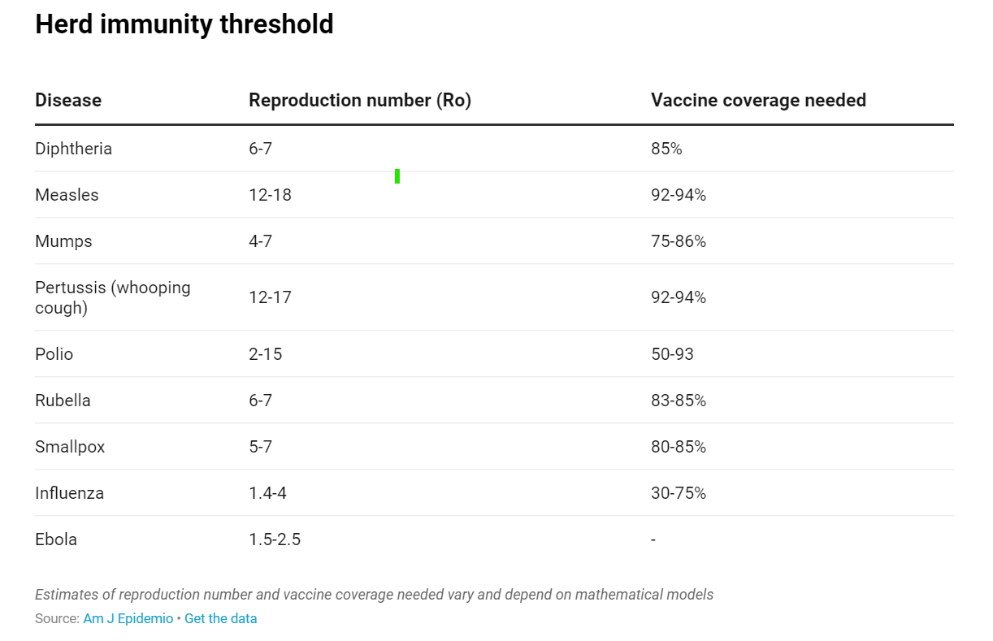
Herd immunity thresholds

Slide 232
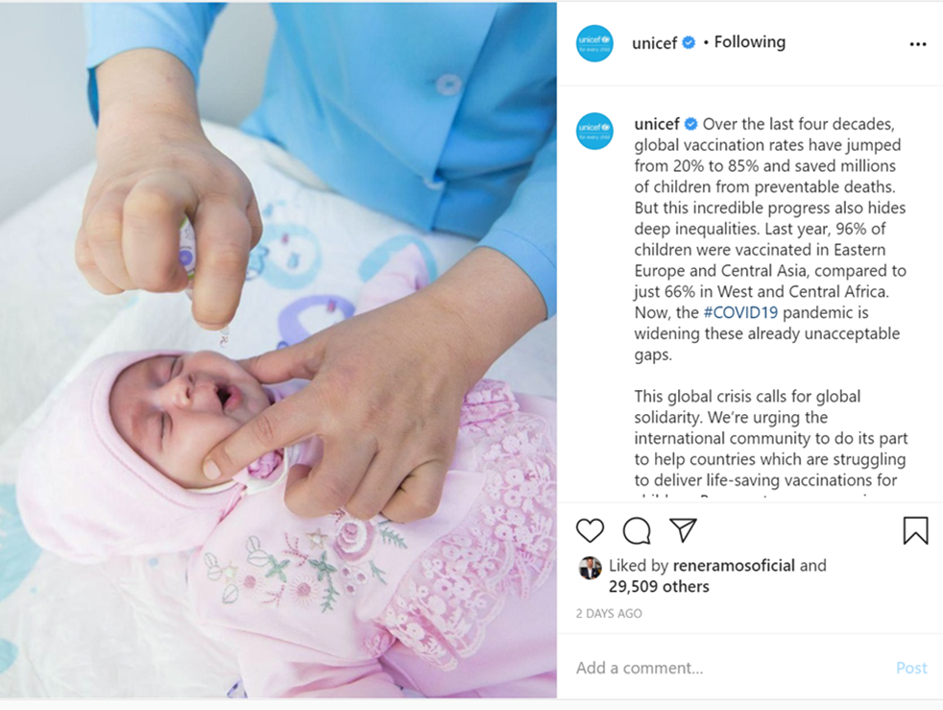
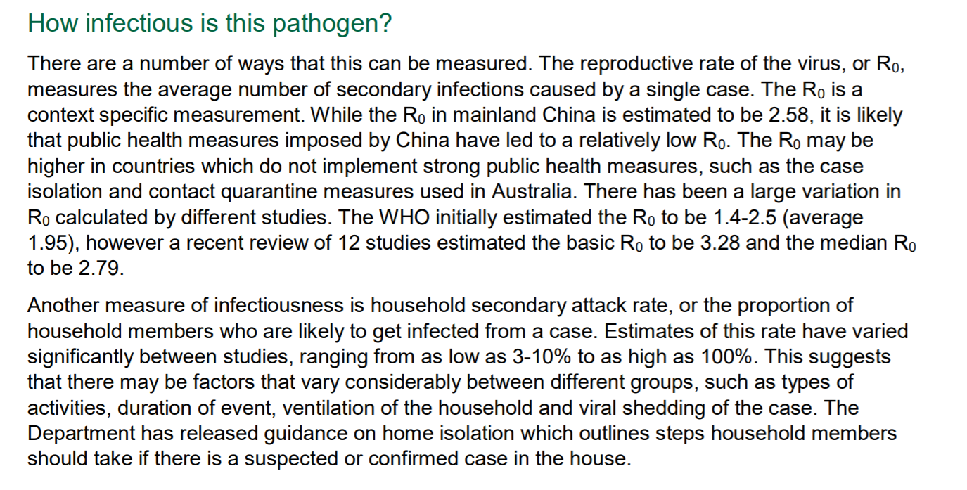
How infectious is covid19? Australian department of Health

Slide 233
Advantages of public immunisation programs
Reduce the risk and spread of a range of diseases.
Limiting the need for ongoing treatment for conditions that are vaccinated against.
Reduces the pressure on the healthcare system fpr preventable diseases.
Increased life expectancy and improved quality of life
Helps protect individuals who have compromised immune systems (ie. Individuals going through chemo)

Slide 234
Disadvantages of public immunisation programs:
Immunisations are still optional. (to some extent)
Antivax movements create hubs of people who are not vaccinated (social norms)
Not everyone can be immunized (immune-compromised, allergies etc)

Slide 235
People who don’t get vaccinated:
‘Conscientious objectors’ are hesitant parents with concerns about immunisation who may decline, delay or be selective in the vaccines they accept. (these parents tend to be more affluent and educated)
Parents who experience barriers to access, which may relate to social disadvantage and logistical barriers.
People who are immune-compromised. (e.g. during chemotherapy)

Slide 236
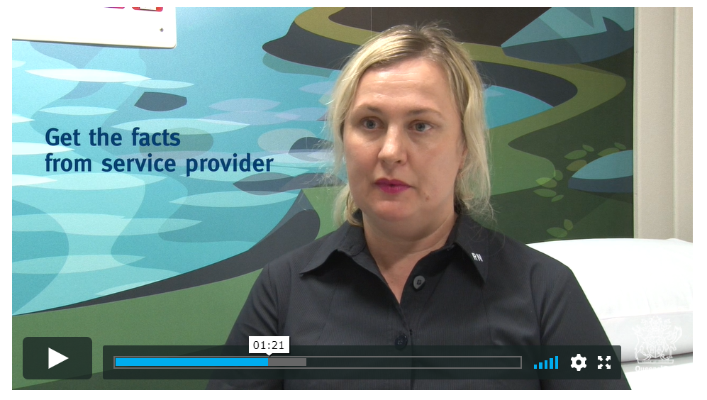
Needle-phobia
The Queensland Government produced a video explaining Needle-phobia. It includes a detailed description, strategies that individuals and parents can use and educates the viewer on why it is important to overcome for the benefit of all.
Watch the video via the link below:
https://www.qld.gov.au/health/conditions/immunisation/benefits#transcript

Slide 237
APPLICATION QUESTION:
Complete Q28 from the 2016 WACE exam:
Extended response:
Choose and health care reform you have studied in this course.
Name of reform: _____________________________________________________
Describe the reform and it’s purpose (3 marks)
Outline who is eligible to participate in the reform (2 marks)
Describe the advantages and disadvantages of the reform for consumers. (10 marks)
**Answer this question for each of the three reforms we have studied ☺

Slide 238
WACE question 2016 Q28 answers
Name of reform: Private Health Insurance Rebate
Describe the reform and it’s purpose (3 marks)
Private Health Insurance (PHI) helps individuals pay for healthcare that is not covered by the universal public healthcare in Australia called Medicare. PHI requires individuals to pay premiums, so the insurance company can then use to assist with private healthcare costs such as dental care and ambulance/hospital care. The government provides a rebate by contributing to the payments for private healthcare insurance. The rebate in income tested. The purpose is to encourage higher income earning individuals to use private healthcare which reduces the overall demand for the public system, allowing lower income earners to utilize the public system more effectively and ultimately, experience optimal health.

Slide 239
WACE question 2016 Q28 answers
Name of reform: Private Health Insurance Rebate
b) Outline who is eligible to participate in the reform (2 marks)
All Australians are eligible to purchase PHI. High income earners are more likely to purchase PHI than low income earners as they are more likely to have excess income to spend on products and services that are not essential, yet beneficial. To be eligible for the rebate, individuals must have a complying health insurance policy with an Australian-registered health insurer and be eligible for medicare. To be eligible for the rebate the individual must have an income less than the tier 3 income threshold.

Slide 240
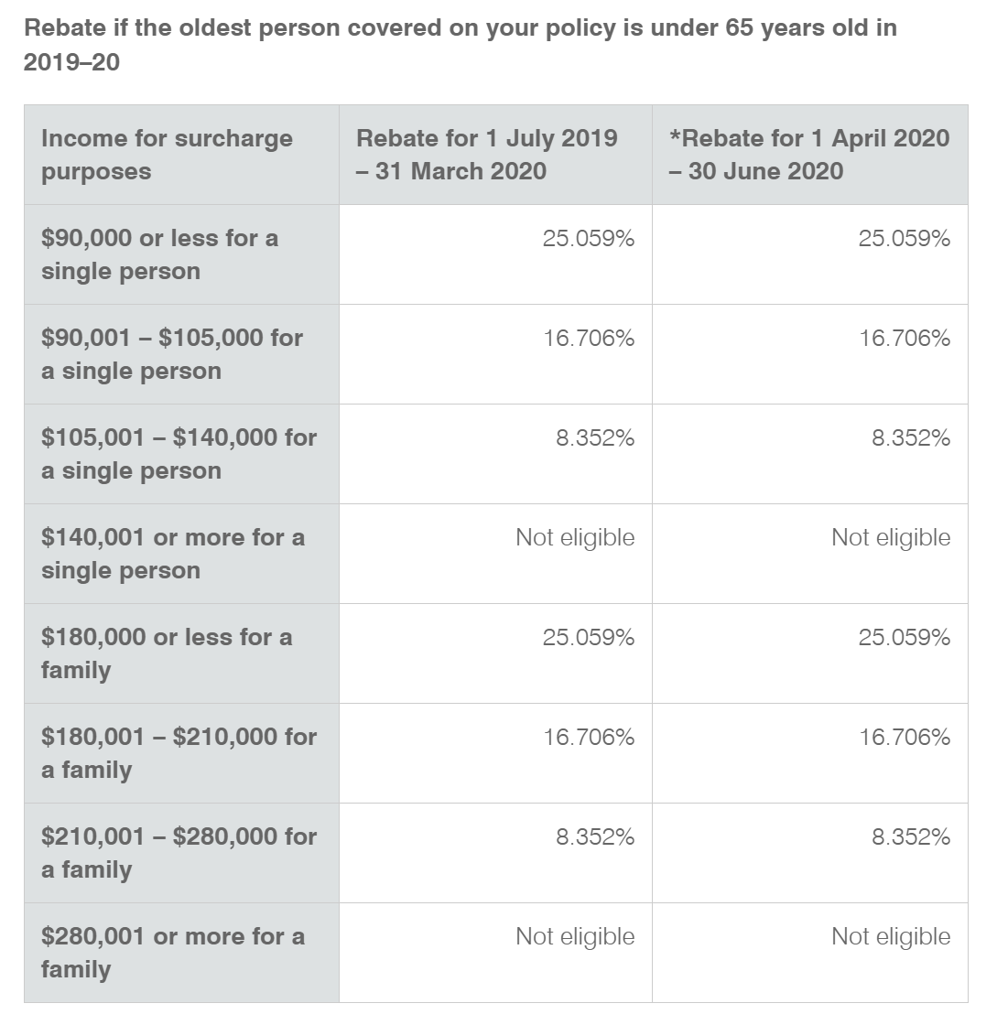
FYI ☺

Slide 241
WACE question 2016 Q28 answers
Name of reform: Private Health Insurance Rebate
c) Describe the advantages and disadvantages of the reform for consumers. (10 marks)
ADVANTAGES:
reduces the burden on the public health system so low-income earners have increased access to healthcare as they require it.
the rebate provides financial incentive for individuals who can afford PHI to purchase it by reducing tax
Reduced waiting times for some healthcares services for individuals who have PHI
Individuals who have PHI have more choice in which healthcare services they use and which healthcare professionals they see.
Individuals with PHI have access to healthcare that is not covered by Medicare. For example, dental, physio, optical and ambulance use can be covered.
Individuals who pay for PHI avoid the medicare levy surcharge.

Slide 242
WACE question 2016 Q28 answers
Name of reform: Private Health Insurance Rebate
c) Describe the advantages and disadvantages of the reform for consumers. (10 marks)
DISADVANTAGES:
It may widen the gap between higher income and lower income earners, as higher income earners gain access to increased healthcare services. (creates health inequity)
It is an extra financial cost outlay. Weekly, fortnightly or monthly payments may be expensive.
Not all health services are covered, or services may be covered in part, meaning there is still a financial cost for treatments.
The process for understanding PHI and the rebate is complex and can be difficult to comprehend. This may reduce access for individuals who have low health literacy levels.
Individuals may not see the benefit of purchasing private health insurance. (their financial outlay may not reflect the benefits if they are not using health services enough)

Slide 243
WACE question 2016 Q28 answers
Name of reform: Pharmaceutical Benefits Scheme (PBS)
Describe the reform and it’s purpose (3 marks)
The PBS provides timely, reliable and affordable access to necessary medicines for Australians. The government subsidizes the cost of a range of medicines to ensure all Australians can access the medications they require. The purpose is to ensure all Australians have access to medications when they need them to both optimize health outcomes and meet economic objectives.

Slide 244
WACE question 2016 Q28 answers
Name of reform: Pharmaceutical Benefits Scheme (PBS)
b) Outline who is eligible to participate in the reform (2 marks)
All Australians who hold a Medicare card are entitled to benefits under the PBS. Some people can receive further benefits (concession card holders) over the general PBS. (non card holders). Individuals who are visiting Australia from selected countries with reciprocal agreements (United Kingdom, Ireland, New Zealand, Malta, Italy, Sweden, the Netherlands, Finland, Norway, Belgium and Slovenia.)
Individuals who have concession cards are eligible for further reductions in the cost of medicines through the PBS.

Slide 245
WACE question 2016 Q28 answers
Name of reform: Pharmaceutical Benefits Scheme (PBS)
c) Describe the advantages and disadvantages of the reform for consumers. (10 marks)
ADVANTAGES:
It reduces the cost for medications for majority of the population.
It covers a wide range of medications that are commonly used by Australians
Access to necessary medicines can reduce incidence of hospitalisation and associated costs, therefore placing less burden on health care resources
Governments can bargain more effectively on behalf of consumers to ensure that newly patented medications are made available at more favourable prices
Data from PBS medications provides data for governments with respect to types of medications, quantity, dose and strength being dispensed

Slide 246
WACE question 2016 Q28 answers
Name of reform: Pharmaceutical Benefits Scheme (PBS)
c) Describe the advantages and disadvantages of the reform for consumers. (10 marks)
DISADVANTAGES:
Not all medications are available through the PBS. If an individual's medication is not covered they will have higher costs to treat/manage their condition.
Growth of the list of medications covered by the PBS places increased pressure on the health system (financial pressure)
It is difficult to remove medications from the PBS as this often results in complaints from people who rely on those medications.
Ageing populations may place pressure on governments to provide more medications as part of the scheme, thereby increasing government expenditure and creating dependency model
Chronic conditions often require medication over a long period of time which is costly for governments

Slide 247
WACE question 2016 Q28 answers
Name of reform: Screening/Vaccination Programs
Describe the reform and it’s purpose (3 marks)
The Australian Government funds a range of public screening and vaccination programs. These include screening processes such as breast cancer, bowel cancer and cervical cancer and all vaccines included on the National Immunisation Programme (NIP). These programs are designed to protect all Australians from a range of preventable diseases (immunisations) and to detect early symptoms of a range of diseases that are relatively easy to treat (screening). These programs are free and their overall purpose is to improve the health of Australian citizens.

Slide 248
WACE question 2016 Q28 answers
Name of reform: Public screening/vaccination programs
b) Outline who is eligible to participate in the reform (2 marks)
Australian citizens who hold a medicare card are eligible. In addition to this, the public screening programs are available to people groups who are classified as “high risk” for particular diseases. E.g. Breast cancer screens are free for women every 2 years from ages 50-74. The NIP provides vaccines to individuals at a range of ages free of charge. Additional vaccines are available to priority population groups when they require them (ie pregnant women)

Slide 249
WACE question 2016 Q28 answers
Name of reform: Public Screening/Vaccination Programs
c) Describe the advantages and disadvantages of the reform for consumers. (10 marks)
ADVANTAGES:
Reduce the risk and spread of a range of diseases.
Limiting the need for ongoing treatment for conditions that are vaccinated against.
Reduces the pressure on the healthcare system fpr preventable diseases.
Increased life expectancy and improved quality of life
Helps protect individuals who have compromised immune systems

Slide 250
WACE question 2016 Q28 answers
Name of reform: Public Screening/Vaccination Programs
c) Describe the advantages and disadvantages of the reform for consumers. (10 marks)
DISADVANTAGES:
Immunisations/screening practices are still optional.
Antivax movements create hubs of people who are not vaccinated (social norms)
Not everyone can be immunized (immune-compromised, allergies etc)
Not always free (sometimes there is a cost)
Reduced access for some population groups (ie. Rural and remote)
Motivated for screening can be low in a healthy population

Slide 251
resources
Lockhart, E. (2011). Health Studies Stage 3A-b. Madeley: Print Publishing.
The Department of Health: http://www.health.gov.au/internet/main/publishing.nsf/Content/Home
-The National Immunisation Program Schedule
-The Pharmaceutical Benefits Scheme-Department

Slide 252
PABCAR public health decision making model
Term 2
Week 4

Slide 253
Syllabus content
Steps in the PABCAR public health decision-making model
Identification of the problem
Amenability to change
Benefits and costs of implementing interventions
Acceptability of proposed measures
Recommended actions and monitoring

Slide 254
Are health interventions worth it?
Using the PABCAR model, we can determine if a particular intervention is going to be accepted by the public or not.
It examines the costs and benefits of the intervention strategy and allows for detailed documentation of the issues.
It is designed to be used by health promoters/professionals

Slide 255
Pabcar stands for…
Amenability: willingness to comply and be cooperative. Being receptive to change.
Problem
Amenability to change
Benefits
Costs
Acceptability
Recommended Actions
Let’s elaborate…

Slide 256
PABCAR
What is the problem and its significance?
Is it amenable to change? (amenability=changeability)
Are the intervention benefits greater than the costs?
What is the acceptability of the proposed measures?
What are the recommended actions and how can we monitor the progress?

Slide 257
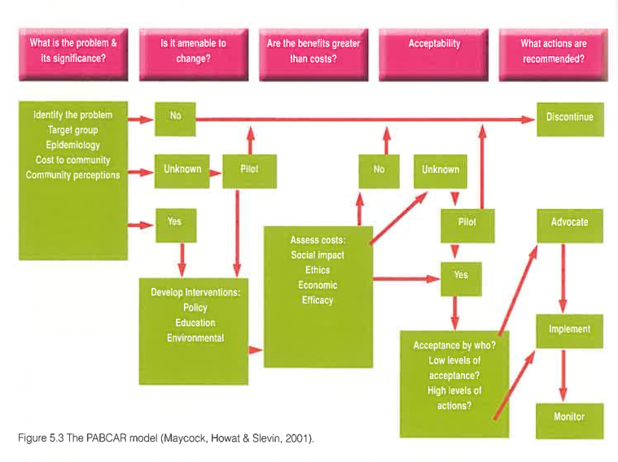
Lets look at the model: (and annotate!)

Slide 258
reading
Read the article by Bruce Maycock, Peter Howat and Terry Slevin.

Slide 259
Application question
Complete Q29 for the 2016 WACE exam:
Step 3 of the PABCAR model of public health is to assess the benefits and costs of implementing an intervention.
In order, what are the other steps in the model? (4 marks)
b) Discuss the benefits and costs of introducing a tax on sugary drinks. (6 marks)

Slide 260
Application question
a) Justify with two (2) examples the use of the PABCAR decision marking model in planning a road safety education program aimed at improving the safety of young people to reduce the incidence of texting and driving (3 marks)
B) Apply the steps of the PABCAR model to planning this road safety intervention program aimed at young people. (12 marks)

Slide 261
Rio Political Declaration on Social Determinants of Health
Term 2
Week 5

Slide 262
Syllabus content
Actions to achieve social and health equity in the Rio Declaration on Social Determinants of Health

Slide 263
Rio political declaration
Rio De Janeiro, Brazil. 21 October, 2011.
At this conference, the World Health Organisation reiterated that health inequities within and between countries are politically, socially and economically unacceptable, unfair, and largely avoidable.
They also claimed that the promotion of health equity is vital to move forward and improve the quality of life and wellbeing for all.

Slide 264
WHO recognises that health inequities arise from the societal conditions in which people are born, grow, live, work and age (social determinants of health)
Things like:
Early years experiences
Education
Economic status
Employment
Housing
Environment
Systems of preventing and treating ill health

Slide 265
Action:
Actions to address the social determinants for vulnerable groups and the entire population is essential to create inclusive, equitable, economically productive and healthy societies.
Good health requires a universal, comprehensive, equitable, effective, responsive and accessible quality health system.

Slide 266
RIO DEclARATIONs 3 Recommendations
3 overarching recommendations
To improve daily living conditions
To tackle the inequitable distribution of power, money and resources
Measure and understand the problem and assess the impact of action

Slide 267
The Rio political declaration:
http://www.who.int/sdhconference/declaration/en/
5 key areas to addressing health inequities:
1. Adopt better governance for health and development
2. Promote participation in policy-making and implementation
3. To further reorient the health sector towards reducing health inequities
4. To strengthen global governance and collaboration
5. To monitor progress and increase accountability.

Slide 268
1. Adopt better governance for health & development
Governance to address the social determinants of health should involve:
Transparent and inclusive decision making processes that give voice to all groups and sectors involved
Developing policies that perform effectively and reach clear and measurable outcomes, build accountability and involve fair policy development processes and results.

Slide 269
2. Promote participation in policy making
Empower and strengthen communities to participate in decision making procedures
Promote inclusive and transparent decision making

Slide 270
3. Further reorient the health sector towards reducing health inequities
Accessibility, availability, acceptability, affordability and quality of healthcare and public health services are essential to the enjoyment of the highest attainable standard of health.
They are one of the fundamental human rights of every human being and the health sector should act to reduce inequities.

Slide 271
4. Strengthen global governance and collaboration
International cooperation and solidarity is important for the equitable benefit of all people.
Multilateral organizations play an important role in:
communicating norms and guidelines
the identification of good practices that support actions on the social determinants of health
the facilitating the access to financial resources and technical cooperation
reviewing and when appropriate, strategically modifying policies and practices that have a negative impact on a persons health and well being

Slide 272
5. Monitor progresses and increase accountability
Monitoring trends in inequities and the impacts of actions to tackle them is important to achieving meaningful progress.
Information systems should facilitate the establishment of relationships between health outcomes and social organization variables.
All accountability mechanisms to guide policy making in all sectors are essential, taking in to account different national contexts.

Slide 273
https://www.youtube.com/watch?v=ES1IX3Mam20
“The enjoyment of the highest attainable standard of health is one of the fundamental rights of every human being without distinction of race, religion, political belief, economic or social condition”
Governments have a responsibility for the health of their peoples, which can be fulfilled only by the provision of adequate health and social measures.
National efforts need to be supported by an enabling international environment.
Health inequities within and between countries are politically, socially and economically unacceptable, they are unfair and largely avoidable.
The promotion of health equity is essential to sustainable development and to a better quality of life and well being for all.

Slide 274
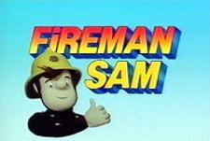

This Photo by Unknown Author is licensed under CC BY-SA-NC
Fireman SAM Poops

Slide 275
Reference
World Health Organization (2011). Rio Political Declaration on Social Determinants of Health. World Conference on Social Determinants of Health.
Lockhart, E. (2011). Health Studies Stage 3A-b. Madeley: Print Publishing.

Slide 276
SEMESTER ONE EXAM REVISION WEEK

